Slide 1
Bible Basics
Study 3: The Promises Of God

Slide 2
www.biblebasicsonline.com www.carelinks.net
Email: info@carelinks.net

Slide 3
3.1 Introduction
If we open the New Testament, the first book we read is a transcript of the Gospel message as preached by Matthew. He starts off in the very first verse by introducing Jesus Christ as the son of David and the son of Abraham, and then gives a genealogy to prove this (Luke does similarly). This may seem odd at first reading. The point is, these early believers recognised that the fulfilment of the promises to Abraham and David through Jesus Christ is the basis of the Christian message. Paul preached likewise- the Gospel is centred in the promises (Gal. 3:8). Paul taught “the good tidings [Gospel] of the promise made unto the [Jewish] fathers” (Acts 13:32 RV).

Slide 4
Paul spoke of the future reward for which he was prepared to lose all things. “Now I stand and am judged for the hope of the promise made of God unto our fathers...the hope of Israel…for which hope’s sake...I am accused” (Acts 26:6,7). He had spent much of his life preaching “glad tidings (the Gospel), how that the promise which was made unto the fathers, God has fulfilled...in that he has raised up Jesus”(Acts 13:32,33). Paul explained that belief in those promises gave hope of resurrection from the dead (Acts 26:6-8 cf. 23:8), a knowledge of the second coming of Jesus in judgment and of the coming Kingdom of God (Acts 24:25; 28:20,31). It must be understood at the outset that the true Christian hope is “the hope of Israel”.

Slide 5
3.2 The Promise In Eden

Slide 6
“I will put enmity (hatred, opposition) between you and the woman, and between your descendant and her (special, notable) descendant; it (the woman’s descendant) shall bruise your head, and you shall bruise his heel” (Gen. 3:15).

Slide 7
The descendant of the woman = Jesus and those in Him
Abraham’s special descendant was Jesus (Gal. 3:16), born of a woman (Gal. 4:4); if we are in Jesus by baptism, then we also are the “descendant” (Gal. 3:27-29).

Slide 8
The descendant of the snake
That or those which have the family likeness of the serpent:
distorting God’s Word
lying
leading others into sin.

Slide 9

The Essential Serpent

Slide 10
The conflict
“You (the serpent) shalt bruise his heel” (Gen. 3:15). This person was to crush permanently the serpent, i.e. sin - “it shall bruise your head”. Hitting a snake on the head is a deathblow. A snake bruising the heel of a man is a temporary wound.

Slide 11
“Jesus Christ, who has (by the cross) abolished death (and therefore the power of sin - Rom. 6:23), and has brought life and immortality to light through the Gospel” (2 Tim. 1:10).
“God sending His own Son in the likeness of sinful flesh, and for sin, condemned sin, in the flesh”, i.e. the Biblical devil, the serpent (Rom. 8:3).
Jesus “was manifested to take away our sins” (1 Jn. 3:5).
On the cross, it was by His being ‘bruised’ [an allusion to Gen. 3:15] that we find forgiveness (Is. 53:5 AVmg.).

Slide 12
The conflict on the cross
Is. 53:4,5 describes Christ as being ‘bruised’ by God through his death on the cross. This plainly alludes to the prophecy of Gen. 3:15 that the serpent would bruise Christ.
“When he (John) saw many of the Pharisees and Sadducees (the group of Jews who condemned Jesus) come to his baptism, he said unto them, O generation of (i.e. gendered by, created by) vipers (snakes), who has warned you to flee from the wrath to come?” (Mt. 3:7).

Slide 13
The conflict today
The truth is never popular; knowing it and living it as we should will always create some form of problem for us, even resulting in persecution.
“Am I therefore become your enemy, because I tell you the truth?” (Gal. 4:14-16).
“As then he that was born after the flesh persecuted him that was born after the Spirit (by true knowledge of God’s Word – 1 Pet. 1:23), even so it is now” (Gal. 4:29).
“An unjust man is an abomination to the just: and he that is upright in the way is an abomination to the wicked” (Prov. 29:27). There is a mutual antagonism between the believer and the world.

Slide 14
3.3 The Promise To Noah

Slide 15
“I, behold, I establish my covenant with you...I will establish my covenant with you (notice the emphasis on “I” - the wonder of God choosing to make promises to mortal man!); neither shall all flesh be cut off any more by the waters of a flood; neither shall there any more be a flood to destroy the earth” (Gen. 9:9‑12).

Slide 16
The earth will not be destroyed.
“The earth which he has established for ever” (Ps. 78:69).
“The earth abides for ever” (Ecc. 1:4).
“Sun and moon...stars...heavens...he has also established them for ever and ever: he has made a decree which shall not pass” (Ps. 148:3-6).
“The earth shall be full of the knowledge of the Lord as the waters cover the sea” (Is. 11:9; Num. 14:21) - difficult, if God lets the earth destroy itself. This promise has not yet been fulfilled.
“God himself that formed the earth and made it; he has established it; he created it not in vain, he formed it to be inhabited” (Is. 45:18). If God made earth only to see it destroyed, then His work was in vain.

Slide 17
3.4 The Promise To Abraham

Slide 18
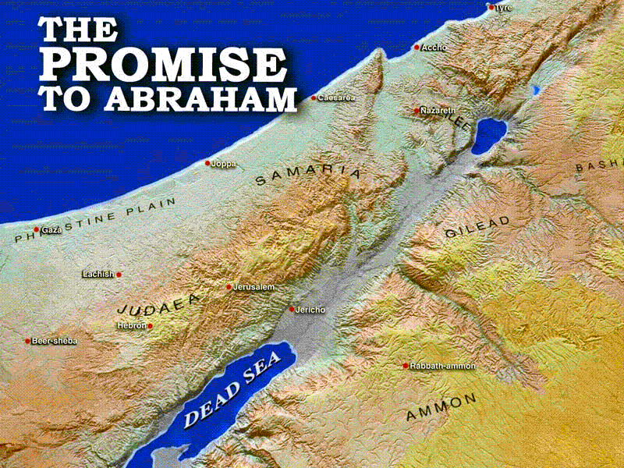

Slide 19
God “preached before the gospel unto Abraham” (Gal. 3:8). So crucial are these promises that Peter started and ended his public proclamation of the Gospel with reference to them (Acts 3:13,25). If we can understand what was taught to Abraham, we will then have a very basic picture of the Christian Gospel.

Slide 20
The Promise to Abraham
is a promise of
Land
A Descendant
Blessing
Personal Relationship with God

Slide 21
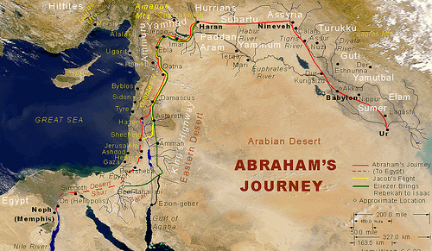

Slide 22
The Land Promise
1. “Get out of your country...unto a land that I will show you” (Gen. 12:1).
2. Abraham “went on his journeys...to Bethel (in Central Israel). And the Lord said unto Abram...Lift up now your eyes, and look from the place where you are northward, and southward, and eastward, and westward: for all the land which you see, to you will I give it, and to your descendant for ever...walk through the land...for I will give it unto you” (Gen. 13:3,14-17).
3. “The Lord made a covenant with Abraham, saying, Unto your descendant [singular- i.e. one special descendant] have I given this land, from the river of Egypt unto the great river, the river Euphrates” (Gen. 15:18).
4. “I will give unto you, and to your descendant [singular- i.e. one special descendant] after you, the land wherein you are a stranger, all the land of Canaan, for an everlasting possession” (Gen. 17:8).

Slide 23
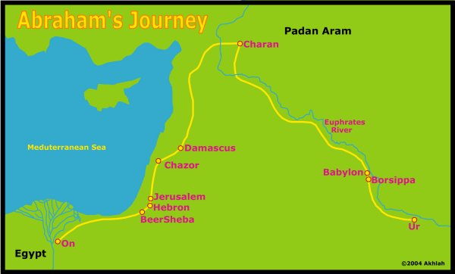

Slide 24
Abraham Didn’t Receive the Promised Land
God “gave him none inheritance in it, no, not so much as to set his foot on: yet he promised that he would give it to him for a possession” (Acts 7:5).
Heb. 11:13,39,40 : “These all died in faith, not having received the promises; God having provided some better thing for us, that they without us should not be made perfect”.
Hebrews 11:8-10⁸ By faith Abraham, when called to go to a place he would later receive as his inheritance, obeyed and went, even though he did not know where he was going. ⁹ By faith he made his home in the promised land like a stranger in a foreign country; he lived in tents, as did Isaac and Jacob, who were heirs with him of the same promise. ¹⁰ For he was looking forward to the city with foundations, whose architect and builder is God

Slide 25
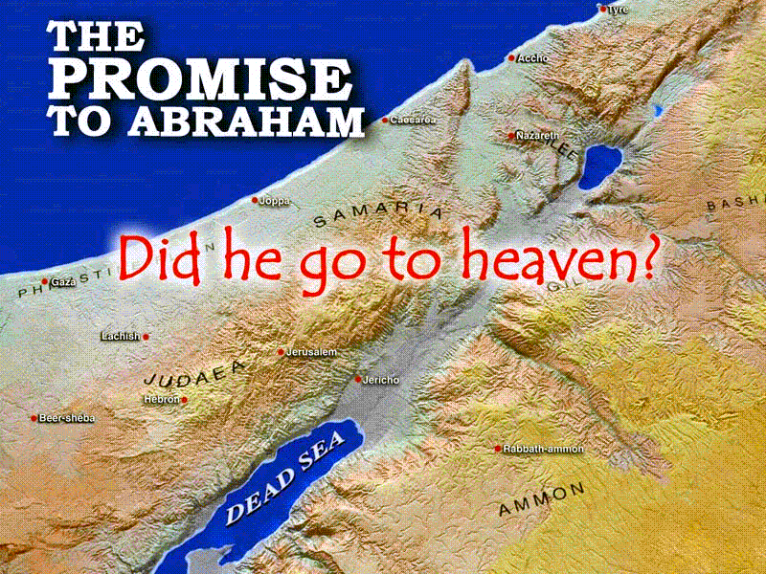

Slide 26
The Promise of the Descendant
The Covenants of Promise to Abraham and David

Slide 27
The Descendant
1. “I will make of you a great nation, and I will bless you...and in you shall all families of the earth be blessed” (Gen. 12:2,3).
2. “I will make your descendant as the dust of the earth: so that if a man can number the dust of the earth, then shall your descendant also be numbered...all the land which you see, to you will I give it, and to your descendant for ever” (Gen. 13:15,16).
3. “Look now toward heaven, and count the stars, if you be able to number them...So shall your descendant be...Unto your descendant have I given this land” (Gen. 15:5,18).
4. “I will give unto...your descendant[s] after you...the land of Canaan, for an everlasting possession; and I will be their God” (Gen. 17:8).
5. “I will multiply your descendant as the stars of the heaven, and as the sand which is upon the sea shore; and your descendant shall possess the gate of his enemies; and in your descendant shall all the nations of the earth be blessed” (Gen. 22:17,18).

Slide 28
The Special Descendant was Jesus
“He (God) doesn’t say, ‘And to descendants’, in the plural, but in the singular, ‘And to your descendant’, which is Christ” (Gal. 3:16).
“...the covenant which God made with our fathers, saying unto Abraham, And in your descendant shall all the tribes of the earth be blessed. Unto you first God, having raised up his Son Jesus (i.e. the descendant), sent him to bless you, in turning away every one of you from his iniquities” (Acts 3:25,26).
Notice here how Peter quotes and interprets Gen. 22:18.
The descendant = Jesus
The blessing = forgiveness of sins.

Slide 29
Becoming Part Of The Descendant
We have to become intimately part of Jesus, so that the promises to the descendant are shared with us as well. This is by baptism into Jesus (Rom. 6:3-5); frequently we read of baptism into his name (Acts 2:38; 8:16; 10:48; 19:5).
Gal. 3:27-29: “As many of you (i.e. only as many!) as have been baptised into Christ have put on Christ. There is neither Jew nor Greek (Gentile), there is neither slave nor free man, there is neither male nor female: for you are all one (through being) in Christ Jesus (by baptism). And if you be Christ’s (by baptism into him), then are you Abraham’s descendants, and heirs according to the promise”.

Slide 30
The Continuity of the Gospel
The two strands of the promises given to Abraham:
1. The Land
2. The Descendant
The early Christians preached:-
1. “The things concerning the Kingdom of God
and
2. The name of Jesus Christ” (Acts 8:12).

Slide 31
3.5 The Promise To David

Slide 32
2 Samuel 7
“And when your days are fulfilled, and you shall sleep with your fathers, I will set up your descendant after you, which shall proceed out of your body, and I will establish his kingdom. He shall build an house for my name, and I will establish the throne of his kingdom forever. I will be his father, and he shall be my son. If he commit iniquity, I will chasten him with the rod of men, and with the stripes of the children of men: But my mercy shall not depart away from him, as I took it from Saul, whom I put away before you. And your house and your kingdom shall be established forever before you: your throne shall be established forever” (v.12-16).

Slide 33
Jesus is the Special Son of David
“I am the...offspring of David”, Jesus said (Rev. 22:16).
“(Jesus), made of the family [AV “seed”] of David according to the flesh” (Rom. 1:3).
“Of this man’s descendants (David’s) has God, according to His promise, raised unto Israel a saviour, Jesus” (Acts 13:23).
The angel told the virgin Mary concerning her son, Jesus: “The Lord God shall give unto him the throne of his father (ancestor) David...and of his Kingdom there shall be no end” (Lk. 1:32,33). This is applying the promise of David’s descendant, in 2 Sam. 7:13, to Jesus.

Slide 34
The Virgin Birth of Jesus
“Your descendant...which shall proceed out of your body...I will be his father, and he shall be my son.” “...of the fruit of your body will I set upon your throne” (2 Sam. 7:12,14; Ps. 132:10,11). Jesus, the descendant, was to be a literal, bodily descendant of David, and yet have God as his Father. This could only be achieved by the virgin birth as described in the New Testament; Jesus’ mother was Mary, a descendant of David (Lk. 1:32), but he had no human father.

Slide 35
The House Built by Jesus
“He shall build an house for my name” (2 Sam. 7:13) shows that Jesus will build a temple for God. God’s “house” is where He is willing to live, and Is. 66:1,2 tells us that He will come to live in the hearts of men who are humble to His word. Jesus is therefore building a spiritual temple for God to dwell in, made up of the true believers. Descriptions of Jesus as the foundation stone of God’s temple (1 Pet. 2:4-8) and of Christians as the temple stones (1 Pet. 2:5) now slot into place.

Slide 36
Sitting on David’s Throne
“I will establish the throne of his (Christ’s) kingdom for ever... your (David’s) house and your kingdom... your throne shall be established for ever” (2 Sam. 7:13,16 cf. Is. 9:6,7). Applied to Jesus in Lk. 1:31-35. Christ’s kingdom will therefore be based on David’s kingdom of Israel; this means that the coming kingdom of God will be a re-establishment of the kingdom of Israel. To fulfil this promise, Christ must reign on David’s “throne”, or place of rulership. This was literally in Jerusalem. The kingdom must be established here on earth in order to fulfil these promises.

Slide 37
The Kingdom
“Your house and your kingdom shall be established for ever before you” (2 Sam. 7:16) suggests that David would witness the establishment of Christ’s eternal kingdom. This was therefore an indirect promise that he would be resurrected at Christ’s return so that he could see with his own eyes the kingdom being set up world-wide, with Jesus reigning from Jerusalem.

Slide 38
Wrong Thinking
Popular Christendom has adopted doctrines which flatly contradict these marvellous truths.
If Jesus physically “pre-existed”, i.e. he existed as a person before he was born, then this makes nonsense of these promises that Jesus would be David’s descendant.
If the kingdom of God will be in heaven, then Jesus cannot re-establish David’s kingdom of Israel, nor can he reign from David’s “throne” or place of rulership. These things were literally on the earth, and so their re-establishment must be in the same place.

Slide 39
The Covenants of Promise to Abraham and David
Do they include you?
Yes!

Slide 40
Is it offered to you?
Yes!

Slide 41
www.biblebasicsonline.com www.carelinks.net
Email: info@carelinks.net

Slide 42
Study 3: Questions
1. Which of God's promises predicts a constant struggle between sin and the righteous?
The promise to Noah
The promise in Eden
The promise to David
The promise to Abraham
2. Which of the following statements are true concerning the promise in Eden?
The seed of the serpent is Lucifer
Christ and the righteous are the woman's seed
The seed of the serpent was temporarily wounded by Christ
The seed of the woman was bruised by Christ's death.
3. Where would Abraham's seed live for ever?
In Heaven
In the city of Jerusalem
On the earth
Some in Heaven and some on earth.
4. Which of the following were promised to David?
That his great descendant would reign for ever
That his 'seed' would have a Kingdom in Heaven
That the seed would be God's son
That his seed, Jesus, would live in Heaven before birth on earth.
5. How can we become the seed of Abraham?
______________________________________________________________
6. Will the earth ever be destroyed?
7. How do God's promises prove your answer to question 6?
______________________________________________________________
8. Explain the promise in Eden in Genesis 3:15

