Slide 1
MISINGI YA BIBLIA
Study 6: God And Evil
SOMO LA 6: Mungu na Ubaya
www.carelinks.net

Slide 2
www.biblebasicsonline.com www.carelinks.net
Email: info@carelinks.net

Slide 3
SOMO LA 6.1 Mungu na Ubaya

Slide 4
God Has 100% Power; No Dualism
5Mimi ndimi BWANA, wala hakuna mwingine, zaidi yangu hakuna Mungu. Nitakutia nguvu, ingawa wewe hukunitambua, 6 ili kwamba kutoka aawio ya jua mpaka machweo yake, watu wapate kujua kwamba hakuna Mungu mwingine ila Mimi. Mimi ndimi BWANA wala hakuna mwingine. 7 Mimi ninaumba nuru na kuhuluku giza, ninaleta mafanikio na kusababisha maafa, Mimi, BWANA, hufanya vitu hivi vyote. Isaya / Isaiah 45:5-7

Slide 5
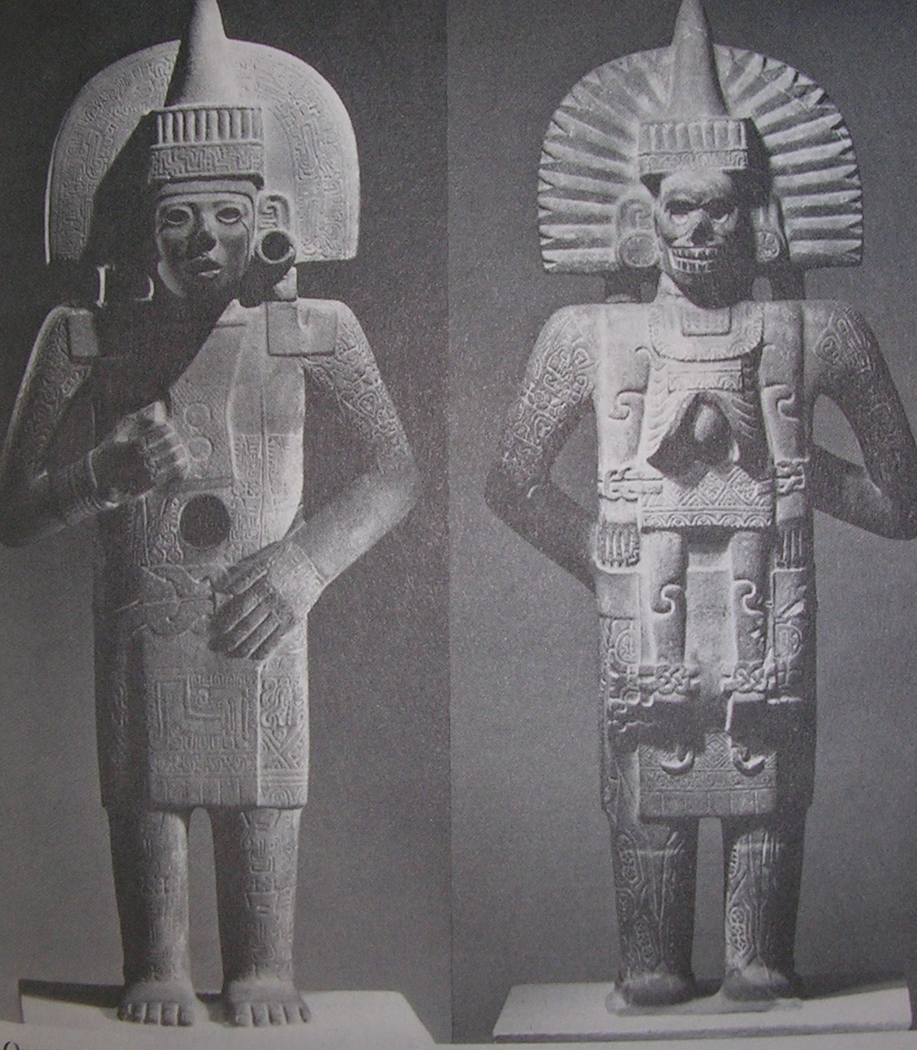

Slide 6
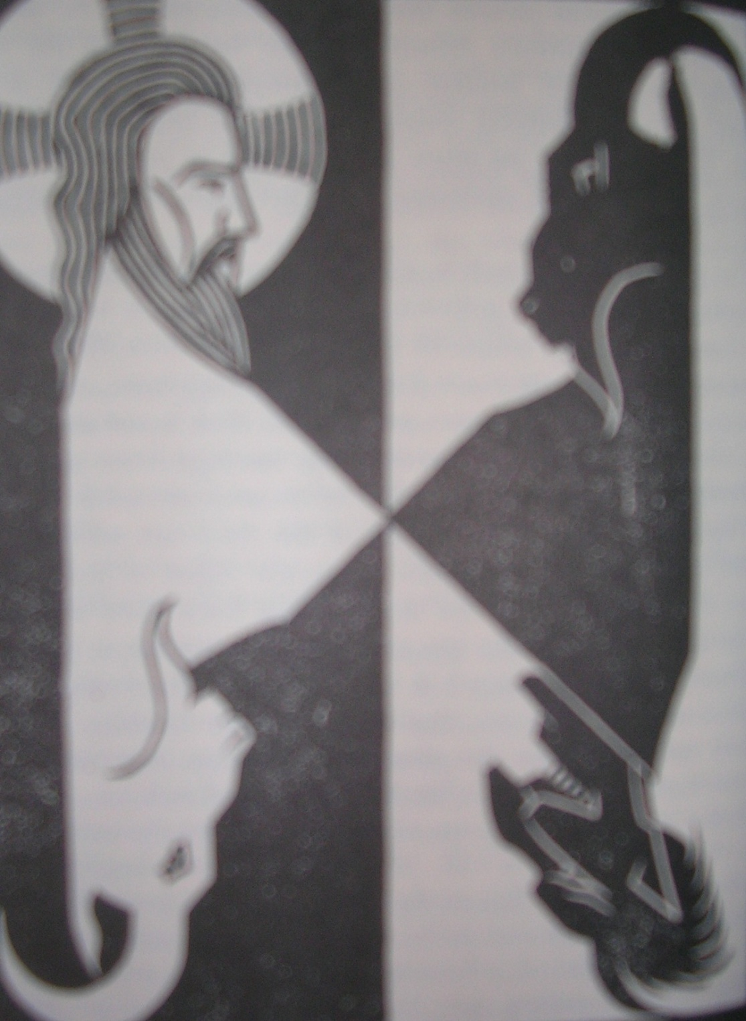

Slide 7
Amosi 3:6 anasema kwamba ukiwapo ubaya mjini, ni Mungu amefanya.
Basi Mika 1:2 anasema kwamba "msiba -ubaya umeshuka toka kwa Bwana umefika mpaka lango la Yerusalemu”.
Notes:
Amosi 3:6 Is a trumpet blown in a city, and the people are not afraid? Does disaster come to a city, unless the LORD has done it? Micah 1:12 For the inhabitants of Maroth wait anxiously for good, because disaster has come down from the LORD to the gate of Jerusalem.

Slide 8
Exod / Kutoka 4:11 Then the LORD said to him, “Who has made man‘s mouth? Who makes him mute, or deaf, or seeing, or blind? Is it not I, the LORD? BWANA akamwambia, ‘‘Ni nani aliyempa mwandamu kinywa? Ni nani aliyemfanya mtu kuwa kiziwi au bubu? Ni nani anayempa mtu kuona au upofu? Je, si mimi, BWANA?
Job / Ayubu 1:21; 2:10 And he said, “Naked I came from my mother‘s womb, and naked shall I return. The LORD gave, and the LORD has taken away; blessed be the name of the LORD.” ‘‘Nilitoka tumboni mwa mama yangu uchi, nami nitaondoka uchic, BWANA alinipa, naye BWANA ameviondoa, jina la BWANA litukuzwe.’’ 2:10 But he said to her, “You speak as one of the foolish women would speak. Shall we receive good from God, and shall we not receive evil?” 10Akamjibu, “Unazungumza kama vile ambavyo mwanamke mpumbavua ye yote angelinena. Je, tupokee mema mikononi mwa Mungu, nasi tusipokee na udhia?’’

Slide 9
Heb. Waebrania 12: 6-11 kwa sababu Bwana huwaadibisha wale
awapendao na humwadhibu kila mmoja anayemkubali kuwa mtoto Wake.” 7 Vumilieni taabu kwa ajili ya kufunzwa adabu. Mungu anawatendea ninyi kama watoto Wake, kwa maana ni mtoto yupi asiyeadibishwa na mzazi wake? 8 Kama hakuna kuadibishwa (ambalo ni fungu la watoto wote), basi ninyi ni watoto wa haramu wala si watoto halali. 9 Tena, sisi sote tunao baba wa kimwili, waliotuadibisha nasi tukawaheshimu kwa ajili ya hilo. Je, si inatupasa kujinyenyekeza zaidi kwa Baba wa roho zetu ili tuishi? 10 Baba zetu walituadibisha kwa kitambo kidogo kama wao wenyewe walivyoona vema, lakini Mungu hutuadibisha kwa faida yetu ili tupate kushiriki utakatifu Wake. 11 Kuadibishwa wakati wo wote hakuonekani kuwa kitu cha kufurahisha bali chenye maumivu kinapotekelezwa. Lakini baadaye huzaa matunda ya haki na amani kwa wale waliofunzwa nayo.

Slide 10
God Is Greater Than ‘Satan’; Adversaries Help Us To Salvation
1Cor. 1 Wakorinto 5:5 mkabidhini mtu huyu kwa Shetani, ili asili ya dhambi iangamizwe lakini roho yake iokolewe katika siku ya Bwana. you are to deliver this man to Satan for the destruction of the flesh, so that his spirit may be saved in the day of the Lord.
1Timotheo 1:20 Miongoni mwao wako Himenayo na Aleksanda, ambao nimemkabidhi Shetani ili wafundishwe wasije wakakufuru among whom are Hymenaeus and Alexander, whom I have handed over to Satan that they may learn not to blaspheme.

Slide 11
Romans / Warumi 6:23 For the wages of sin is death, but the free gift of God is eternal life in Christ Jesus our Lord.
Kwa maana mshahara wa dhambi ni mauti, bali karama ya Mungu ni uzima wa milele katika Kristo Yesu Bwana wetu.

Slide 12
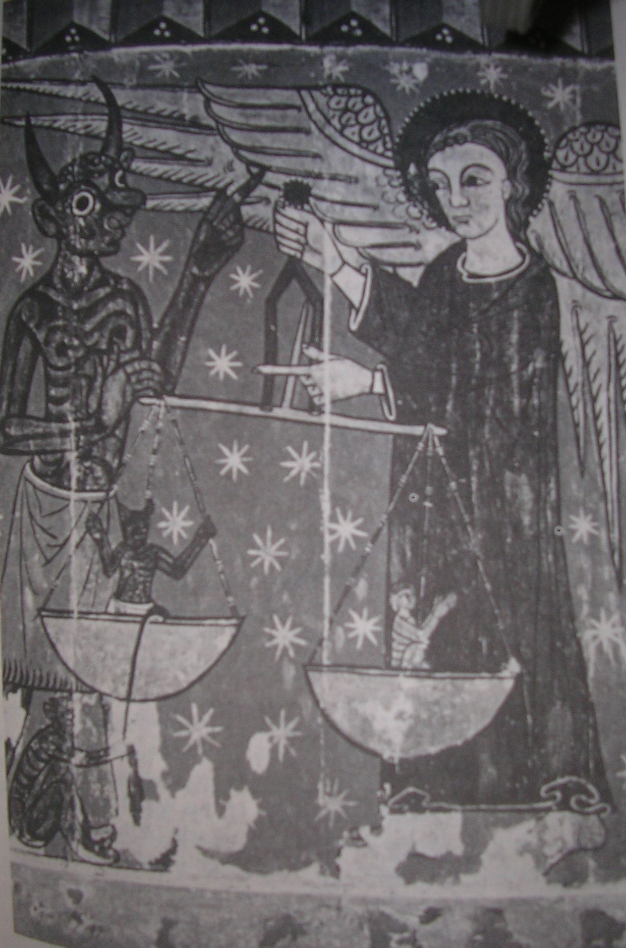

Slide 13
Sin From Within
Marko 7:15,21-23 15 Hakuna kitu kinachomwingia mtu kimtiacho unajisi, lakini kile kimtokacho ndicho kimtiacho unajisi... 21 Kwa maana kutoka ndani ya moyo wa mtu hutoka: Mawazo mabaya, uasherati, wizi, uuaji, uzinzi, tamaa mbaya, uovu, udanganyifu, ufisadi, wivu,matukano, kiburi na upumbavu. Maovu haya yote hutoka ndani ya mtu nayo ndiyo yamtiayo mtu unajisi.’’

Slide 14
Genesis / Mwanzo 8:21 the LORD said in his heart, "I will never again curse the ground because of man, for the intention of man's heart is evil from his youth”.
BWANA akasikia harufu nzuri ya kupendeza, naye akasema moyoni mwake, “Kamwe sitailaani tena ardhi kwa sababu ya mwanadamu, hata ingawaje kila mwelekeo wa moyo wake ni mbaya tangu ujana. Kamwe sitaangamiza tena viumbe hai vyote kama nilivyofanya.’’

Slide 15
James / Yakobo 1:13-15 Mtu anapojaribiwa asiseme, ‘‘Ninajaribiwa na Mungu’’ kwa maana Mungu hawezi kujaribiwa na maovu wala Yeye hamjaribu mtu ye yote. Lakini kila mtu hujaribiwa wakati anapovutwa na kudanganywa na tamaa zake mwenyewe. Basi ile tamaa akiisha kuchukua mimba, huzaa dhambi, ile dhambi ikikomaa, huzaa mauti.

Slide 16
Romans / Warumi 7:15-18 Sielewi nitendalo, kwa maana lile ninalotaka kulitenda, silitendi, lakini ninatenda lile ninalolichukia. 16 Basi kama ninatenda lile nisilotaka kutenda, ni kwamba ninakubali kuwa sheria ni njema. 17 Lakini, kwa kweli si mimi tena nitendaye lile nisilotaka bali ni ile dhambi ikaayo ndani yangu. 18 Kwa maana ninafahamu kwamba hakuna jema lo lote likaalo ndani yangu, yaani, katika asili yangu ya dhambi. Kwa kuwa nina shauku ya kutenda lililo jema, lakini siwezi kulitenda.

Slide 17
Rom. / Warumi 7:19-23
Sitendi lile jema nitakalo kutenda bali lile baya nisilolitaka, ndilo nitendalo. Basi kama ninatenda lile nisilotaka kutenda, si mimi tena nifanyaye hivyo, bali ni ile dhambi ikaayo ndani yangu.
Hivyo naiona sheria ikitenda kazi. Ninapotaka kutenda jema, jambo baya liko papo hapo. Kwa maana katika utu wangu wa ndani naifurahia sheria ya Mungu. Lakini ninaona kuna sheria nyingine inayotenda kazi katika viungo vya mwili wangu inayopigana vita dhidi ya ile sheria ya akili yangu.Sheria hii inanifanya mateka wa ile sheria ya dhambi inayofanya kazi katika viungo vya mwili wangu.
Notes:
For I do not do the good I want, but the evil I do not want is what I keep on doing. Now if I do what I do not want, it is no longer I who do it, but sin that dwells within me. So I find it to be a law that when I want to do right, evil lies close at hand. For I delight in the law of God, in my inner being, but I see in my members another law waging war against the law of my mind and making me captive to the law of sin that dwells in my members.

Slide 18
Yeremia 17:9 Moyo ni mdanganyifu kuliko vitu vyote, ni mwovu kupita kiasi. Ni nani awezaye kuujua?
Yer. 18:12 Lakini wao watajibu, ‘Hakuna faida. Tutaendelea na mipango yetu wenyewe, kila mmoja wetu atafuata ukaidi wa moyo wake mbaya.’ ’’
Waefeso 4:18 Watu hao akili zao zimetiwa giza na wametengwa mbali na uzima wa Mungu kwa sababu ya ujinga wao na ugumu wa mioyo yao
Notes:
17:9 The heart is deceitful above all things, and desperately sick; who can understand it? 18:12 "But they say, 'That is in vain! We will follow our own plans, and will every one act according to the stubbornness of his evil heart.’ Eph 4:18 They are darkened in their understanding, alienated from the life of God because of the ignorance that is in them, due to their hardness of heart.

Slide 19
Psalm / Zaburi 119:11 I have stored up your word in my heart, that I might not sin against you.
Nimelificha neno lako moyoni mwangu ili nisikutende dhambi.

Slide 20
The Word “Satan” In The Bible
NENO 'SHETANI’ KATIKA BIBLIA

Slide 21
1 Wafalme 11: 14 imetolewa taarifa ya kwamba "Bwana akamwondokeshea - yaani, aliamsha adui wa Suleimani (neno lile lile la Kiebrania kila mahali limetafsiriwa"Shetani”), Hadadi Mwedomi”."Tena, Mungu akamwondokeshea adui mwingine (Shetani mwingine), Rezoni ….. naye akawa adui (shetani) wa Israeli" (1 Wafal. 11: 23, 25).
Notes:
1Kings 11:14 And the LORD raised up an adversary against Solomon, Hadad the Edomite.
1Kings 11:23 God also raised up as an adversary to him, Rezon the son of Eliada,

Slide 22
2 Sam. 24: 1 pameandikwa:"Tena …. Bwana akamtia nia Daudi juu yao - Israeli" ili afanye sensa ya Israeli. Maelezo yaliyo sambamba katika
1 M / Nyakati 21: 1 unasema kwamba"Tena shetani akasimama juu ya Israeli, akamshawishi Daudi kuwahesabu Israeli"
Notes:
2Samuel 24:1 Again the anger of the LORD was kindled against Israel, and he incited David against them, saying, "Go, number Israel and Judah.”
1Chronicles 21:1 Then Satan stood against Israel and incited David to number Israel.

Slide 23
Mathayo 16:21-23
Tangu wakati huo Yesu alianza kuwaeleza wanafunzi wake kwamba hana budi kwenda Yerusalemu na kupata mateso mengi kwa mikono ya wazee, wakuu wa makuhani na walimu wa sheria na kwamba itampasa auawe na siku ya tatu atafufulika.
22 Petro akamchukua kando akaanza kumkemea, akisema, “Mungu apishie hayo mbali! Jambo hili kamwe halitakupata!!’’
23 Lakini Yesu akageuka na kumwambia Petro , “Rudi nyuma yangu, Shetani! Wewe ni kikwazo kwangu. Moyo wako hauwazi yaliyo ya Mungu, bali ya wanadamu.’’
Notes:
Mt. 16:21-23 21 From that time Jesus began to show his disciples that he must go to Jerusalem and suffer many things from the elders and chief priests and scribes, and be killed, and on the third day be raised. And Peter took him aside and began to rebuke him, saying, “Far be it from you, Lord! This shall never happen to you.“ But he turned and said to Peter, "Get behind me, Satan! You are a hindrance to me. For you are not setting your mind on the things of God, but on the things of man.“

Slide 24
The Word “Devil” in the Bible
NENO 'IBILISI’ KATIKA BIBLIA

Slide 25
John Yohana 6:70,71 Ndipo Yesu akajibu, ‘‘Je, sikuwachagua ninyi kumi na wawili? Lakini mmoja wenu ni ibilisi.’’ (Hapa alikuwa anasema juu ya Yuda, mwana wa Simoni Iskariote. Ingawa alikuwa mmoja wa wale kumi na wawili, ndiye ambaye baadaye angemsaliti Yesu.)
1Timotheo 3:11 Vivyo hivyo wake zao wawe wanawake wanaostahili heshima, wasiozungumza maneno ya kuwadhuru wengine, bali wawe na kiasi na waaminifu katika kila jambo.
Tito 2:3 3Vivyo hivyo wafundishe wanawake wazee kuwa na mwenendo wa unyenyekevu unaostahili utakatifu, wala wasiwe wasingiziaji au walevi, bali wafundishe yale yaliyo mema,
Notes:
Jesus answered them, “Did I not choose you, the Twelve? And yet one of you is a devil.” He spoke of Judas the son of Simon Iscariot, for he, one of the Twelve, was going to betray him.
1Tim.3:11 Their wives likewise must be dignified, not slanderers, but sober-minded, faithful in all things.
Titus 2:3 Older women likewise are to be reverent in behavior, not slanderers

Slide 26
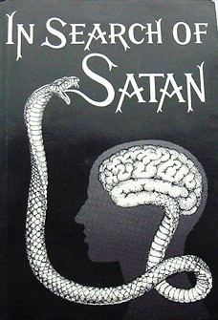
The Devil and Sin
DHAMBI NA IBILISI

Slide 27
Waebrania 2:14,15 Basi kwa kuwa watoto wana nyama na damu, Yeye pia alishiriki katika ubinadamu wao, ili kwa kifo chake, apate kumwangamiza huyo mwenye nguvu za mauti, yaani, Shetani, na kuwaweka huru wale waliokuwa utumwani maisha yao yote kwa sababu ya kuogopa mauti.
Notes:
Heb. 2:14,15 Since therefore the children share in flesh and blood, he himself likewise partook of the same things, that through death he might destroy the one who has the power of death, that is, the devil, and deliver all those who through fear of death were subject to lifelong slavery.

Slide 28
Waebrania 2:14 apate kumwangamiza huyo mwenye nguvu za mauti, yaani, Shetani
Yakuba 1:15 Basi ile tamaa akiisha kuchukua mimba, huzaa dhambi, ile dhambi ikikomaa, huzaa mauti.
Notes:
Heb 2:14 the one who has the power of death, that is, the devil
James 1:15 sin when it is fully grown brings forth death.

Slide 29
Waebrania 2:14 14Basi kwa kuwa watoto wana nyama na damu, Yeye pia alishiriki katika ubinadamu wao, ili kwa kifo chake, apate kumwangamiza huyo mwenye nguvu za mauti, yaani, Shetani
Warumi 8:3: Kwa maana kile ambacho sheria haikuwa na uwezo wa kufanya, kwa vile ilivyokuwa dhaifu katika mwili, Mungu kwa kumtuma Mwanawe mwenyewe kwa mfano wa mwanadamu mwenye mwili ulio wa dhambi na kwa ajili ya dhambi, Yeye aliihukumu dhambi katika mwili
Notes:
Hebrews 2:14 Since therefore the children share in flesh and blood, he himself likewise partook of the same , that through death he might destroy the one who has the power of death, that is, the devil
Romans 8:3: By sending his own Son in the likeness of sinful flesh and for sin, he condemned sin, in the flesh

Slide 30
Waebrania Hebrews 2:14 mwenye nguvu za mauti, yaani, Shetani
the one who has the power of death, that is, the devil
Warumi Romans 6:23 Kwa maana mshahara wa dhambi ni mauti,
The wages of sin is death
Notes:
the one who has the power of death, that is, the devil

Slide 31
Waebrania / Hebrews 9:26; 2:14
9:26 Ingelikuwa hivyo, ingelimpasa Kristo kuteswa mara nyingi tangu kuumbwa kwa ulimwengu. Lakini sasa ametokea mara moja tu katika mwisho wa nyakati aindoe dhambi kwa kujitoa mwenyewe kuwa dhabihu.
2:14Basi kwa kuwa watoto wana nyama na damu, Yeye pia alishiriki katika ubinadamu wao, ili kwa kifo chake, apate kumwangamiza huyo mwenye nguvu za mauti, yaani, Shetani
Notes:
Hebrews 9:26; 2:14
He has appeared once for all at the end of the ages to put away sin by the sacrifice of himself.
14 ...that through death he might destroy the one who has the power of death, that is, the devil

Slide 32
1 Yohana 1 John 3:5,8 You know that he appeared to take away sins, and in him there is no sin.
5 Lakini mwajua ya kuwa Yeye alidhihirishwa ili aziondoe dhambi, wala ndani Yake hamna dhambi.
The reason the Son of God appeared was to destroy the works of the devil.
8 Yeye atendaye dhambi ni wa Ibilisi, kwa sababu Ibilisi amekuwa akitenda dhambi tangu mwanzo. Kwa kusudi hili Mwana wa Mungu alidhihirishwa ili aziangamize kazi za Ibilisi.

Slide 33
Genesis /Mwanzo 3:1 Basi nyoka alikuwa mwerevu kuliko wanyama wote wa porini ambao BWANA Mungu aliowafanya. Nyoka akamwambia mwanamke, “Ati kweli Mungu alisema, ‘Kamwe msile matunda ya mti wo wote wa bustanini?’ ’’
Now the serpent was more crafty than any other beast of the field that the LORD God had made. He said to the woman, "Did God actually say, 'You shall not eat of any tree in the garden'?“

Slide 34
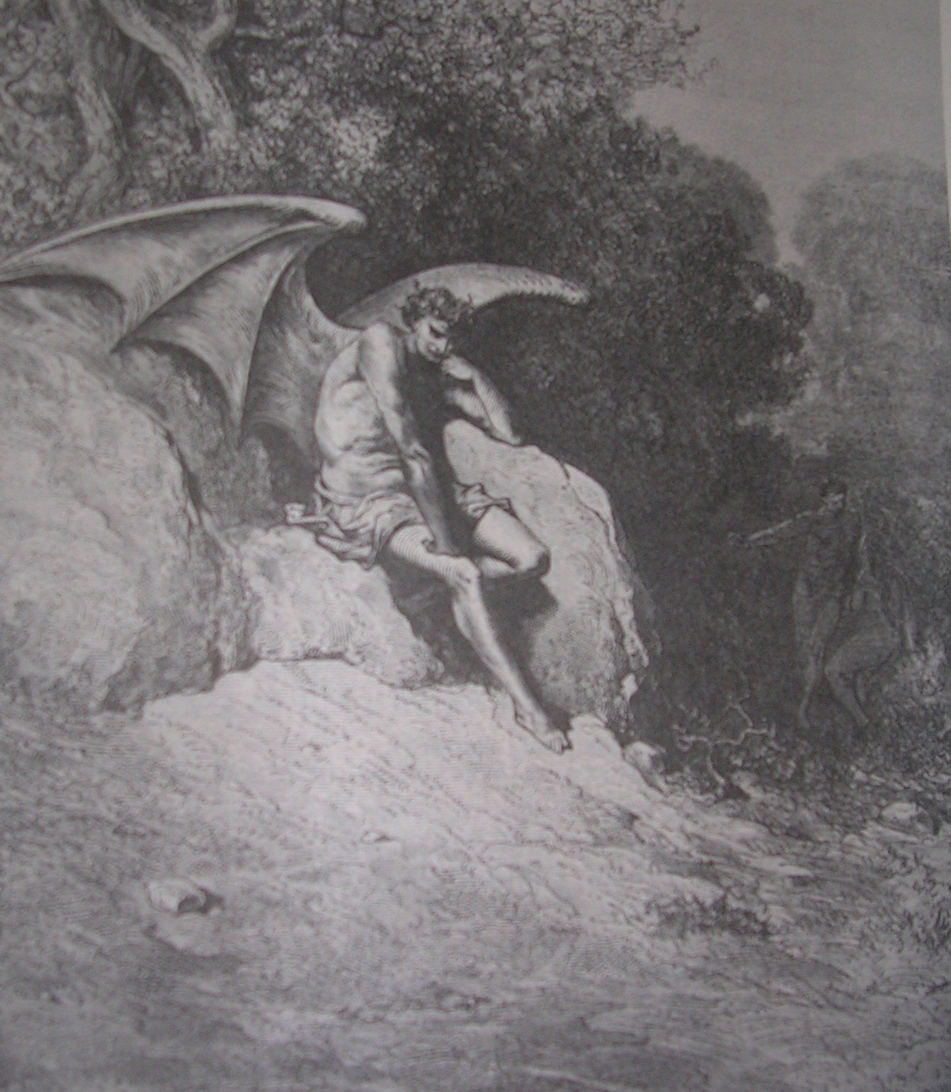

Slide 35
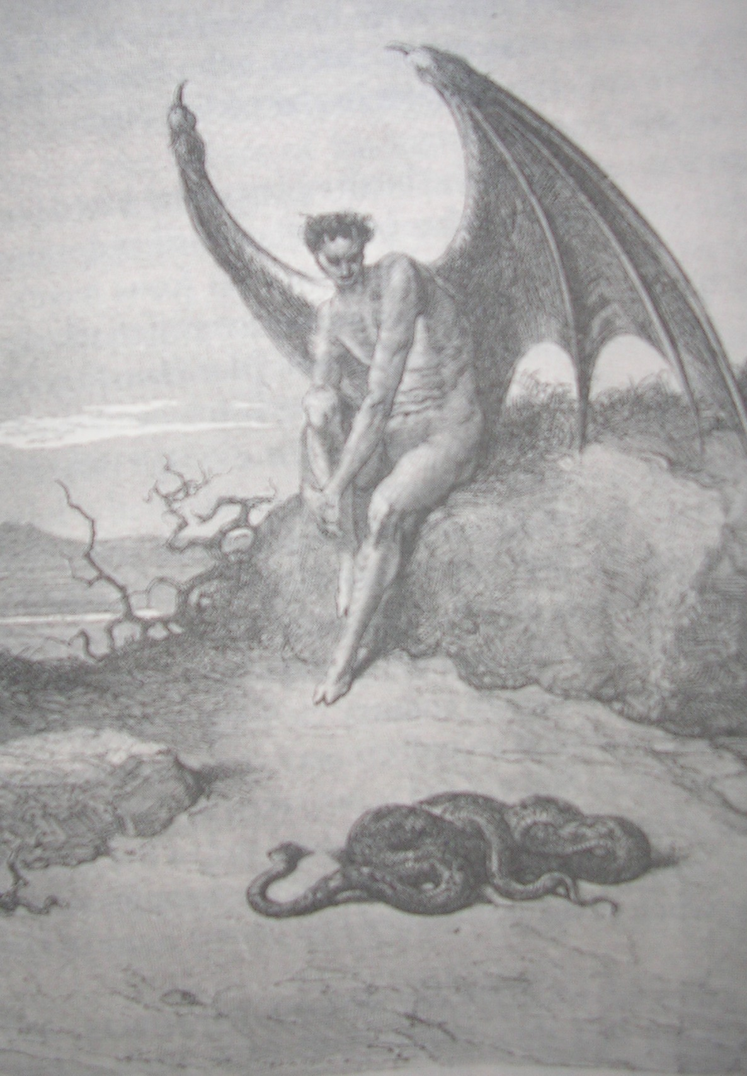

Slide 36
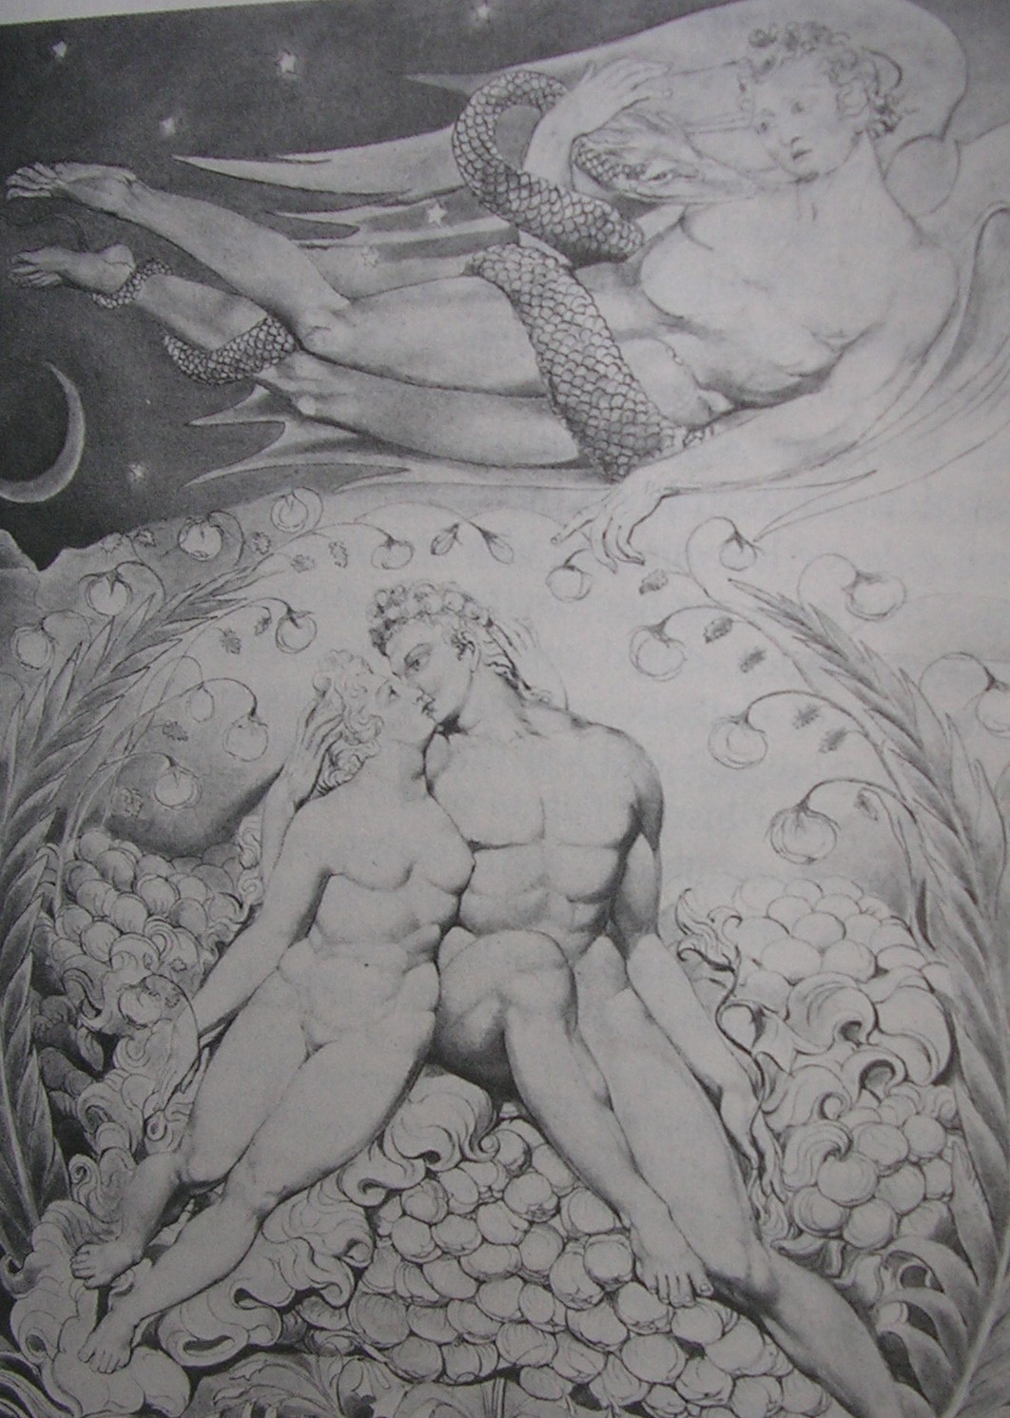

Slide 37
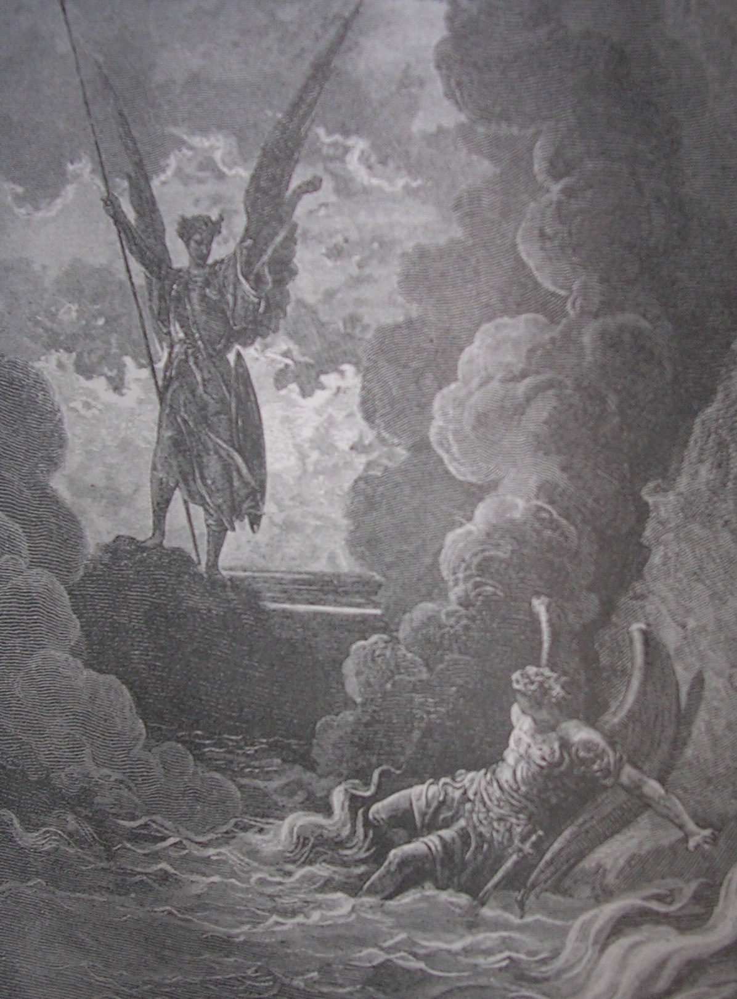

Slide 38
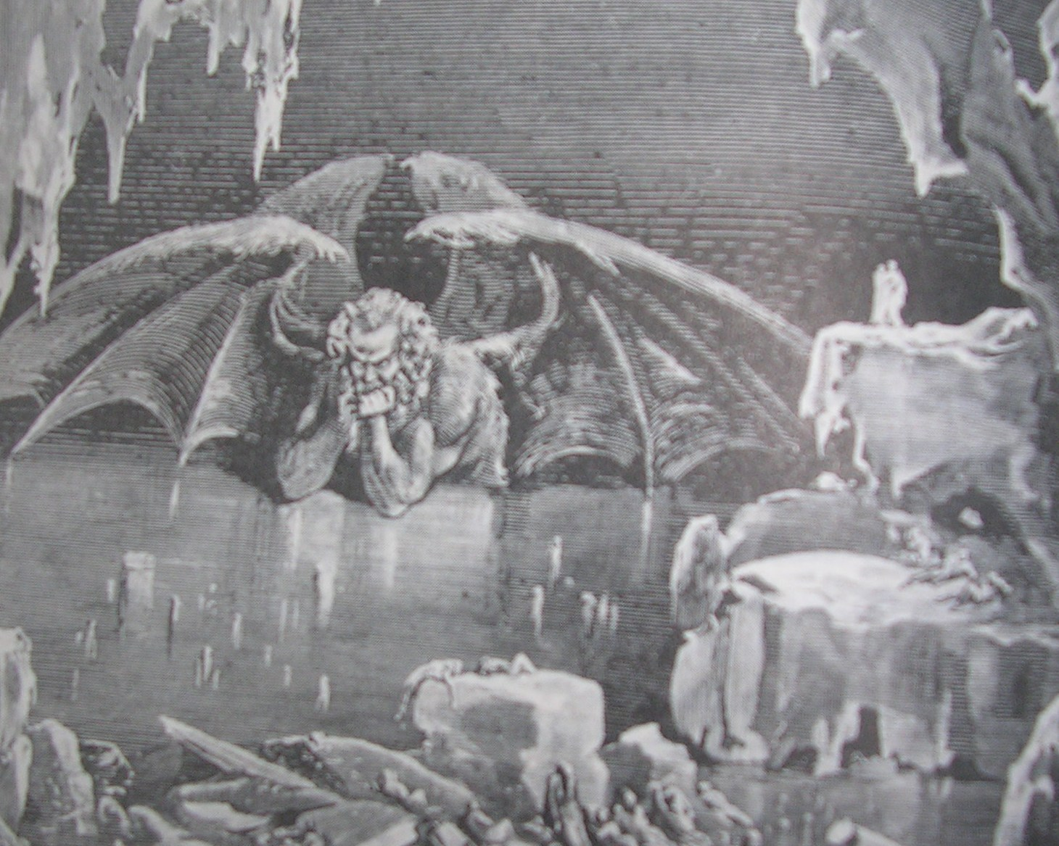

Slide 39
The Size of the Cosmos
Means that the power of any ‘satan’ being is enormous
Does he really have so much power?
Did he really get it from God?

Slide 40
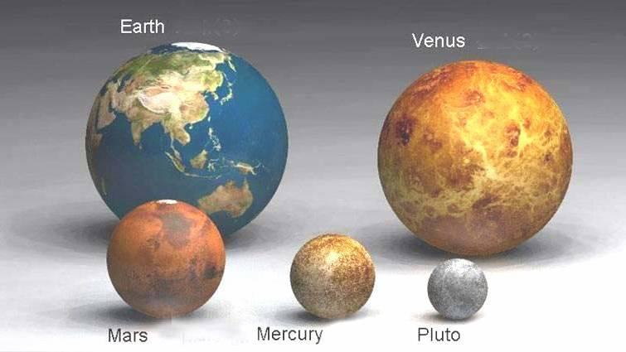

Slide 41
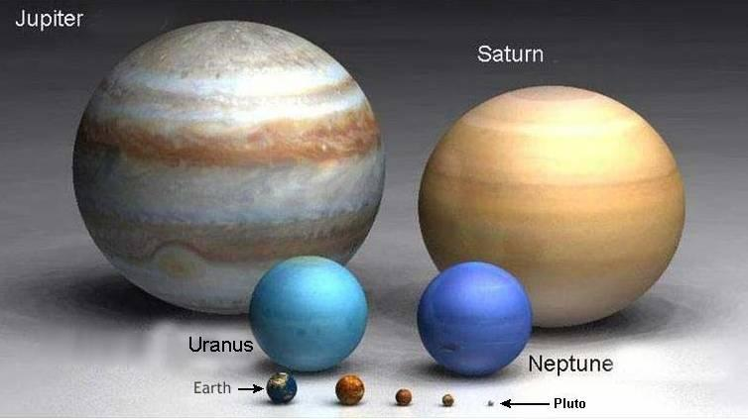

Slide 42
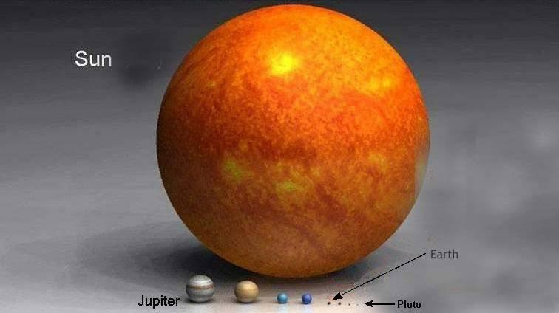

Slide 43
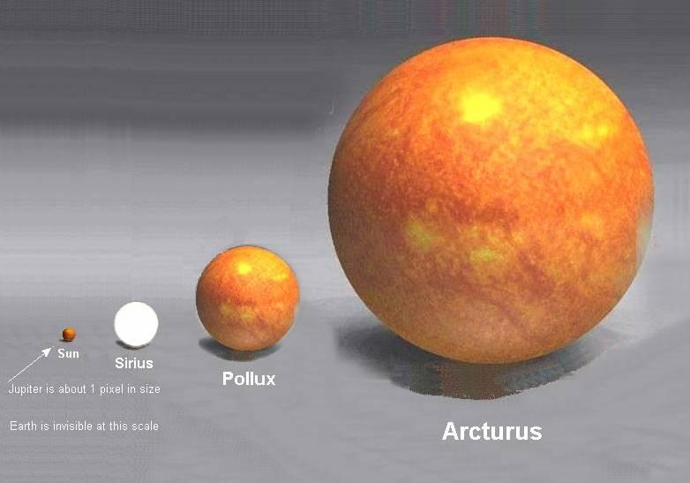

Slide 44
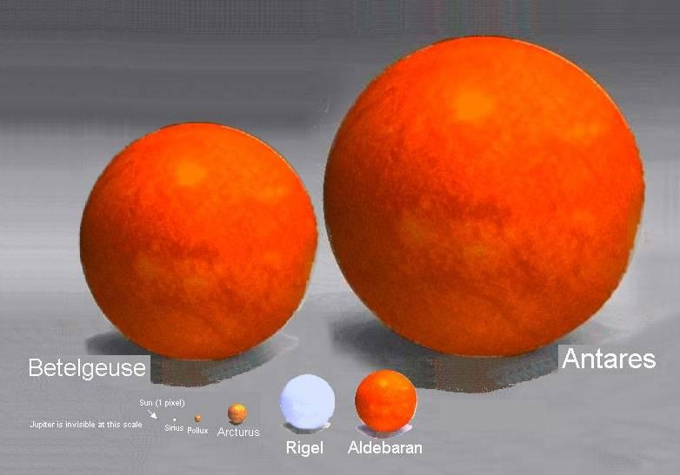

Slide 45
Self Talk
Battle for the mind
“The savage mind” (Levi-Strauss), “The violence within” (Tournier)
Don’t demonize, take responsibility.

Slide 46
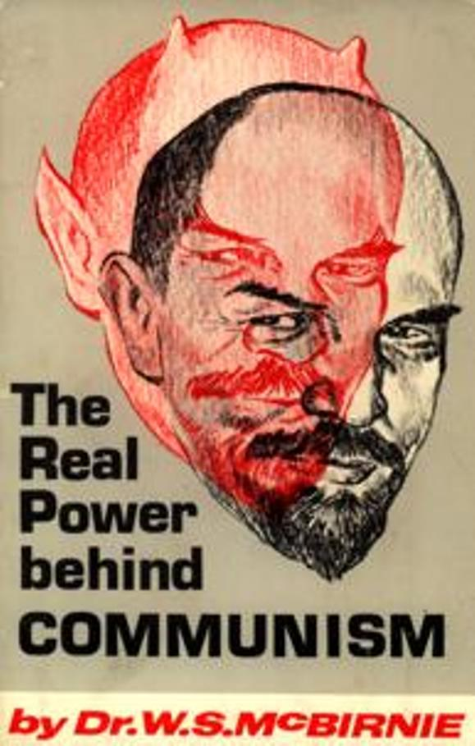
The East is Demonized

Slide 47
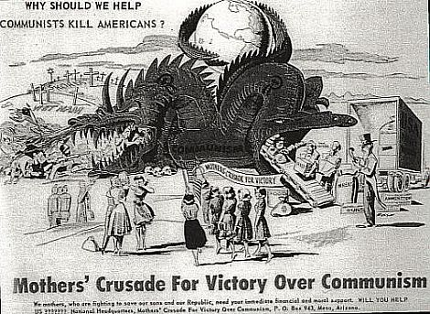

Slide 48
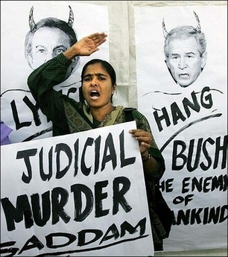
The West is Demonized

Slide 49
www.biblebasicsonline.com www.carelinks.net
Email: info@carelinks.net

Slide 50
Somo La 6: Maswali
Ni nani wa mwisho anayehusika na matatizo na majaribu yetu ?
Mungu / Tukio / Kiumbe mwenye dhambi aitwaye shetani / Viumbe watenda dhambi wanaoitwa mashetani au pepo.
Ni nani anahusika na majaribu yetu kutenda dhambi ?
Mwili wetu wenyewe wanadamu / Mungu / Roho wachafu / Kiumbe mtenda dhambi aitwaye shetani
Neno 'Ibilisi’ maana yeke nini ?
Dhambi / Nyoka / Mshitaki / mchongeaji /Lusifa.
Neno 'Shetani’ lina maana gani ?
Mtenda dhambi / Adui / Mnyama / Mfalme wa pepo
Je ! neno "Shetani" laweza kutumika kwa watu wema ?
‘Shetani’ na'Ibilisi’ kwa maneno ya mifano yaweza kutaja kitu gani ?
Tunaelewa kwa jinsi gani 'pepo’ kama walivyotajwa kwenye Agano Jipya
Malaika watenda dhambi
Magonjwa
Msemo wa siku zile wa magonjwa, ambayo watu walidhani yalisababishwa na'pepo’
Viumbe wa roho.
8. Unamwelewa vipi nyoka wa kwenye bustani ya Edeni ?

Slide 51
Study 6: Questions
1. Where do problems and trials come from?
a) God
b) Chance
c) A sinful being called satan
d) Sinful beings called demons
2. What is responsible for our temptation to sin?
a) Our own human nature
b) God
c) Evil spirits
d) A sinful being called satan
3. What does the word ‘devil’ mean?
a) Sin
b) The serpent
c) False accuser / slanderer
d) Lucifer
4. What does the word ‘satan’ mean?
a) A sinner b) An adversary
c) A beast d) King of demons
5. Can the word ‘satan’ be applied to good people?
6. What can ‘satan’ and ‘devil’ refer to figuratively?
7. How should we understand ‘demons’ as referred to in the New
Testament?
a) Sinful angels b) Sicknesses
c) The language of the day for sicknesses, which people thought were caused by ‘demons’
d) Spirit beings
8. What do you understand by the snake in the garden of Eden?

