Slide 1
Bible Basics / MISINGI YA BIBLIA Study 7: The Origin Of Jesus
SOMO LA 7: Mwanzo wa Yesu

Slide 2
www.biblebasicsonline.com www.carelinks.net Email: info@carelinks.net

Slide 3
7.1 Old Testament Prophecies Of Jesus
7.1 Unabii unaomhusu Yesu kwenye Agano la Kale

Slide 4
Unabii ulio katika Agano la Kale
“Mungu wangu, Mungu wangu, mbona umeniacha ?"(Zaburi 22: 1)
“Laumu ya wanadamu na mzaha wa watu. wote wanionao hunicheka sana, Hunifyonya, wakatikisa vichwa vyao; Husema, umtegemee (yaani, alimtegemea) Bwana; na amponye; na amwokoe sasa, maana apendezwa naye"(Zaburi 22: 6 -8).
"…. Ulimi wangu waambatana na taya zangu; wamenizuia mikono na miguu"(Zab. 22:15,16)
“Wanagawanya nguo zangu, na vazi langu wanalipigia kura"(Zab. 22: 18)
Umetimilika kwa Kristo
Haya yalikuwa kabisa ni maneno ya Yesu palemsalabani (Math. 27: 46).
Israeli walimdharau Yesunao walimdhihaki (Luk. 23:35 8:53); walitikisa vichwa vyao (Math.27:39), walisema haya maneno alipokuwa msalabani (Math. 27:43).
Huu ulitimia Kristo)alipokuwa na kiu msalabani (Yn.19:28). Kuzuiwa mikono na miguu ni tendo la kusulubiwa ambalo limetajwa.
Utimilifu kabisa wa huu unapatikana katika Mathayo. 27:35.
Notes:
Old Testament Prophecy
“I am become a stranger unto my brothers, and am an alien unto my mother’s children. For the zeal of your house has eaten me up” (Ps. 69:8,9)
“They gave me also gall for my meat; and in my thirst they gave me vinegar to drink” (Ps. 69:21)
“As a sheep before her shearers is dumb, so he opens not his mouth” (Is. 53:7)
“He made his grave with the wicked, and with the rich in his death” (Is. 53:9)

Slide 5
7.2 The Virgin Birth
Kuzaliwa na Bikira

Slide 6
The Conception of Jesus / MTUNGO WA MIMBA YA YESU
Malaika Gabrieli akamtokea Mariamu na ujumbe kuwa"tazama, utachukua mimba na kuzaa mtoto mwanamume; na jina lake utamwita Yesu. Huyu atakuwa Mkuu, ataitwa mwana wa Aliye juu ……. Mariamu akamwambia Malaika, Litakuwaje neno hili, maana sijuimume ? (Yaani, alikuwa bikira). Malaika akajibu akamwambia, Roho Mtakatifu atakujilia juu yako, na nguvu zake aliye juu zitakufunika kama kivuli; kwa sababu hiyo hicho kitakachozaliwa kitaitwa kitakatifu, Mwana wa Mungu"(Luk. 1: 31 -35)
Notes:
“You shall conceive in your womb, and bring forth a son, and shall call his name Jesus. He shall be great, and shall be called the Son of the Highest...Then said Mary unto the angel, How shall this be, seeing I know not a man? (i.e. she was a virgin). And the angel answered and said unto her, The Holy Spirit shall come upon you, and the power of the Highest shall overshadow you: therefore also that holy thing which shall be born of you shall be called the Son of God” (Lk. 1:31-35).
Note the 7 future tenses

Slide 7
No Pre-existence of Jesus
Yesu alikuwa ni"Shina na mzao wa Daudi"(Uf. 22: 16), neno la Kigriki'genos’ linadokeza kwamba Yesu'alizaliwa toka’ kwa Daudi.
Ikiwa Yesu alikuwa'mimba’ ndani ya tumbo la Mariamu (Lk. 1:31) ni ushahidi kwamba hakuwahi kuishi kimwili kabla ya wakati huu.
Notes:
Jesus would be the Son of God on his birth; the Son of God did not exist before his birth. Note the 7 future tenses need to be noted - e.g. “he shall be great”. If Jesus were already physically in existence as the angel spoke those words to Mary, he would already have been great. Jesus was the “offspring” of David (Rev. 22:16), the Greek ‘genos’ implying Jesus was ‘generated from’ David. He was born “of” Mary (Lk. 1:35).
He was ‘conceived’ in Mary’s womb (Lk. 1:31) -He could not have physically existed before this time.

Slide 8
The Humanity of Jesus
"Ni nani awezaye kutoa kitu kilicho safi kitoke katika kitu kichafu ? Hapana awezaye. Mwnadamu ni kitu gani hata akawa safi ? huyo aliyezaliwa na mwanamke, hata akawa na haki ? ……… au awezaje kuwa safi aliyezaliwa na mwanamke ?"(Ay. 14:4; 15:14; 25:4).
Mariamu akiwa "amezaliwa na mwanamke”, mwenye wazazi wanadamu wa kawaida, ilibidi alikuwa na uchafu wetu, Mwili wa mwanadamu, ambao naye Yesu akazaliwa nao,"amezaliwa na mwanamke"(Gal 4:4).
Notes:
“Who can bring a clean thing out of an unclean? Not one...What is man, that he should be clean? and he which is born of a woman, that he should be righteous?...how can he be clean that is born of a woman?” (Job 14:4; 15:14; 25:4).
Gal 4:4 But when the fullness of the time came, God sent His Son, born of a woman, born under the law, Diaglott : “Having been produced from a woman”. The Saviour was to be “the seed of the woman” (Gen. 3:15).

Slide 9
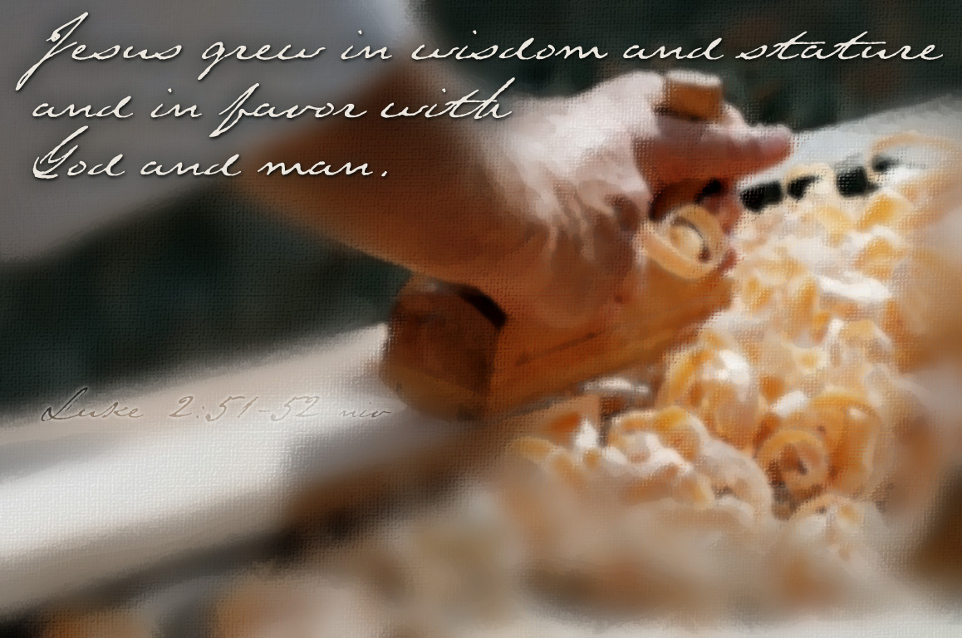
Luke 2:52

Slide 10
7.3 Christ's Place In God's Plan Nafasi ya Kristo katika mpango wa Mungu

Slide 11
Warumi 1:1-4
…….. Yesu Kristo Bwana wetu, aliyezaliwa katika ukoo wa Daudi kwa jinsi ya mwili; na kudhihirishwa kwa uweza kuwa Mwana wa Mungu, kwa jinsi ya roho ya Utakatifu, kwa ufufuo wa wafu’ (Rum. 1:1 -4).
Hivi unaeleza Muhutasari wa historia ya Kristo: -
Aliahidiwa katika Agano la Kale - yaani, katika mpango wa Mungu
Aliumbwa akiwa mtu aliye na mwili kwa kuzaliwa na bikira, akiwa ni mzao wa Daudi;
Kwa ajili ya tabia timilifu (“roho ya Utakatifu”), iliyoonekana wakati wa maisha ya mwili unaopatikana na mauti.
Alifufuliwa, na tena hadharani alielezewa kuwa ni Mwana wa Mungu na mitume waliopewa kipawa cha roho ya kuhubiri.
Notes:
Jesus was “promised before by [God’s] prophets in the holy Scriptures, concerning His son, Jesus Christ our Lord, which was made (created by begettal) of the seed of David according to the flesh; and declared to be the Son of God with power, according to the spirit of holiness, by the resurrection from the dead” (Rom. 1:1-4).
1. Promised in the Old Testament - i.e. in God’s plan;
2. Created as a physical person through the virgin birth, as a seed of David;
3. Due to his perfect character (“the spirit of holiness”), shown during his mortal life
4. He was resurrected, and again publicly declared to be the Son of God by the apostles’ spirit-gifted preaching.

Slide 12
7.4 "In the beginning was the word“ / "Hapo Mwanzo Kulikuwako Neno” Yohana 1: 1-3. Hapo mwanzo kulikuwako Neno, naye Neno alikuwako kwa Mungu, naye Neno alikuwa Mungu. Huyo mwanzo alikuwako kwa Mungu. Vyote vilifanyika kwa huyo"(Yn. 1: 1-3).

Slide 13
- Aghalabu limetafsiriwa kuwa"neno”, lakini vile vile kuwa ni:
Maelezo Kusudi
Kupasha habari Elimu au Mafundisho
Nia Kuhutubu
Hoja Methali
Habari
Notes:
The Meaning of logos. “In the beginning was the Word, and the Word was with God, and the Word was God. The same was in the beginning with God. All things were made by him” (Jn. 1:1-3).
Logos is also translated as
Account, Cause, Communication, Doctrine, Intent, Preaching, Reason, Saying, Tidings

Slide 14
The Logos Became Flesh
“HAPO MWANZO"

Slide 15
www.biblebasicsonline.com www.carelinks.net Email: info@carelinks.net

Slide 16
Somo La 7 : Maswali
Ni taarifa zipi za kweli kumhusu Mariamu ?
Alikuwa mkamilifu, Mwanamke asiye na dhambi / Alikuwa ni Mwanamke wa kawaida / Alipata mimba ya Yesu kwa uwezo Roho Mtakatifu / Kwa sasa anatoa maombi yetu kwa Yesu.
Je ! Yesu aliumba nchi ?
Yohana 1:1-3 unaielewaje ?"Hapo Mwanzo kulikowako neno"kwa nini haimaanishi
Kwa sababu gani unadhani ni muhimu kuwa na hakika kumhusu Yesu endapo alikuwako kimwili kabla hajazaliwa ?
Andika orodha mbili za unabii ulio kwenye Agano la Kale unaomhusu Yesu.
Je ! Kimwili Yesu aliwahi kuwako kabla hajazaliwa ?
Ni katika maana gani Yesu anaweza kusemwa alikuwako kabla ya kuzaliwa kwake?
Akiwa ni Malaika / Akiwa ni sehemu ya Utatu / Akiwa Roho / Ni katika nia na kusudi la Mungu.

Slide 17
STUDY 7: Questions
1. List two Old Testament prophecies concerning Jesus.
2. Did Jesus physically exist before his birth?
Yes / No
3. In what sense can Jesus be said to have existed before his birth?
As an Angel
As part of a trinity
As a spirit
Only in the mind and purpose of God.
4. Which of the following statements are true about Mary?
She was a perfect, sinless woman
She was an ordinary woman
She was made pregnant with Jesus by the Holy Spirit
She now offers our prayers to Jesus.
5. Did Jesus create the earth?
Yes
No
6. What do you understand by John 1:1-3 "In the beginning was the word?"
What does it not mean?
7. Why do you think it is important to be certain about whether Jesus existed physically before his birth?

