Slide 1
Apologetics – Proving that the Bible is authoritative.

Slide 2
2Ti 3:16 All Scripture is God-breathed, and is profitable for doctrine, for reproof, for correction, for instruction in righteousness,

Slide 3
1Jn 4:1 Beloved, do not believe every spirit, but test the spirits, whether they are from God; for many false prophets have gone forth into the world.

Slide 4
1Th 5:21 Prove all things; hold fast that which is good.

Slide 5
Signs and wonders confirmed the word ( Mark 16 v 20). In the same way, we also have signs and wonders we can show people to confirm God’s word.

Slide 6
Rom 1:20 For the invisible things of him from the creation of the world are clearly seen, being understood by the things that are made, even his eternal power and Godhead; so that they are without excuse:

Slide 7
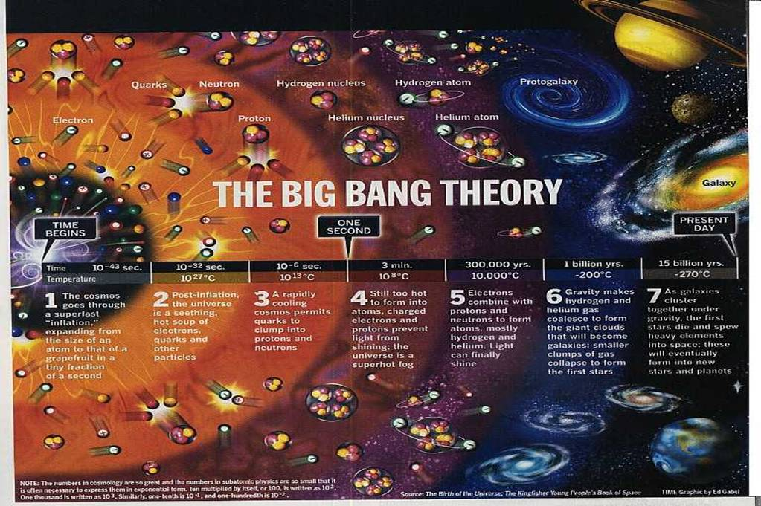

Slide 8


Slide 9
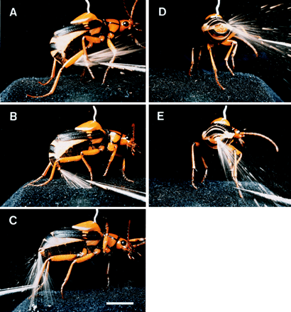

Slide 10
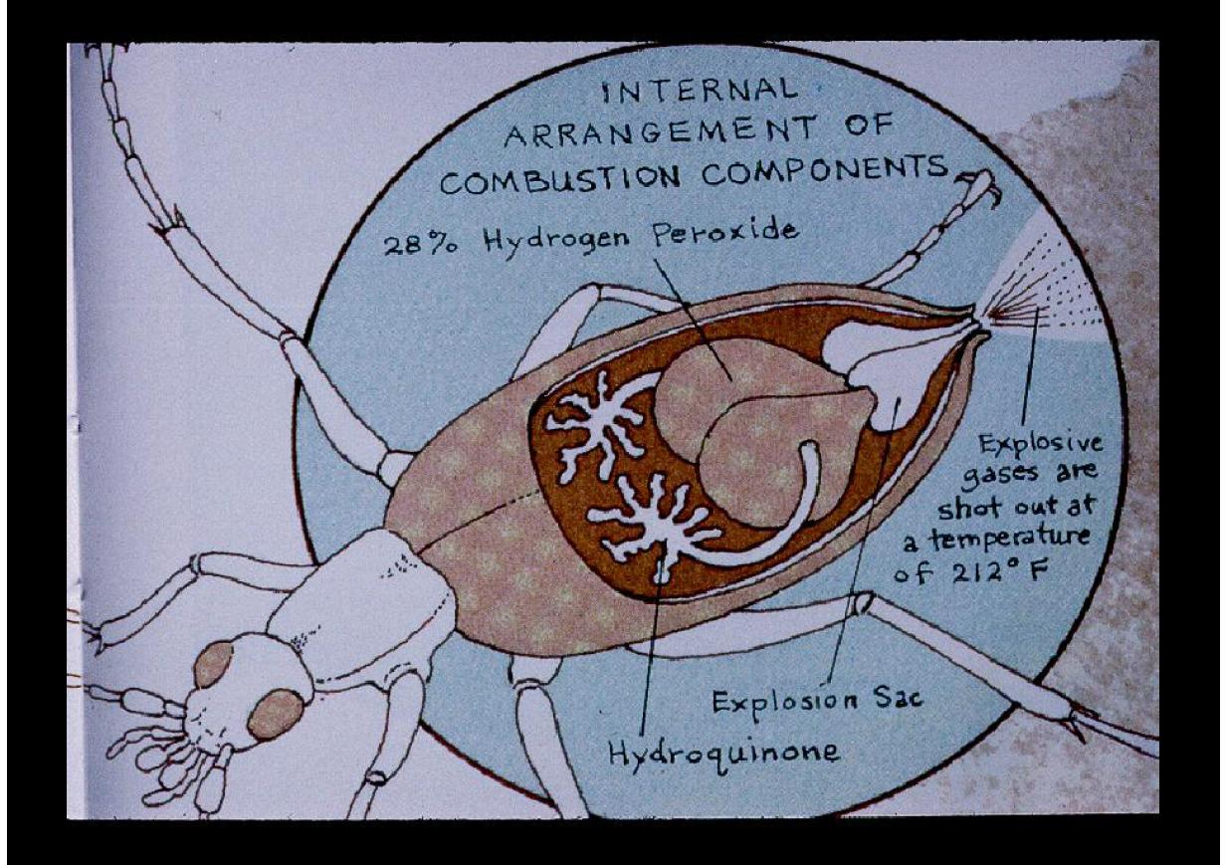

Slide 11
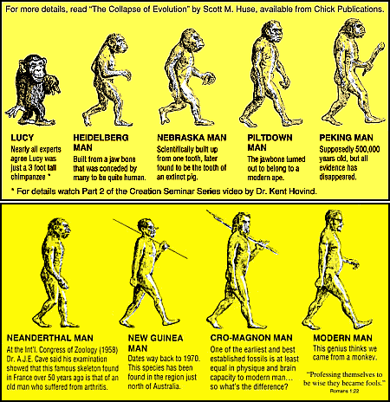

Slide 12
To be termed scientific, a method of inquiry must be based on gathering empirical and measurable evidence subject to specific principles of reasoning.

Slide 13
The Oxford English Dictionary says that scientific method is: "a method or procedure that has characterized natural science since the 17th century, consisting in systematic observation, measurement, and experiment, and the formulation, testing, and modification of hypotheses."

Slide 14
Dating of samples is based on assumption.

Slide 15
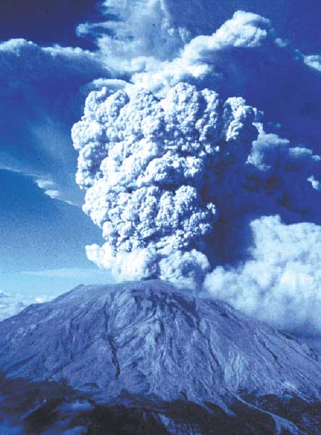

Slide 16
Mount St Helens adds up to a real life laboratory to understand a number of processes that occurred on a much larger scale, during Noah’s Flood. At
Mount St Helens, these processes were observed to rapidly form a wide range of geological features, in contrast to the thousands to millions of years assumed by mainstream scientists. Mount St
Helens demonstrates that when we bring the Flood back into our thinking, a large percentage of the uniformitarian time challenges melt away.

Slide 17
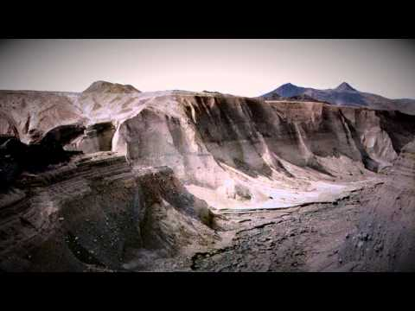

Slide 18
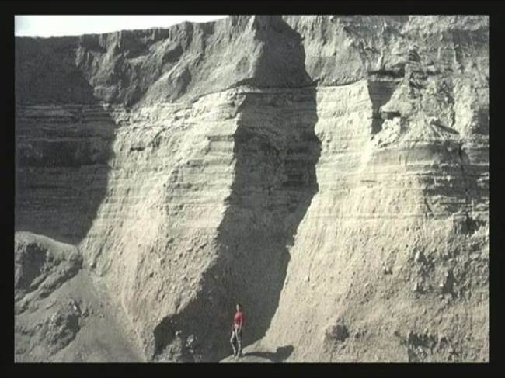

Slide 19


Slide 20
It takes more faith to believe in evolution than to believe in God – an intelligent creator who created us for a purpose.

Slide 21
Exo 20:11 For in six days the LORD made heaven and earth, the sea, and all that in them is, and rested the seventh day: wherefore the LORD blessed the sabbath day, and hallowed it.

Slide 22
Gen 1:5 And God called the light Day, and the darkness he called Night. And the evening and the morning were the first day.

Slide 23
Theistic evolution:
A merging of the 2 views to satisfy a poor Bible student.
Rom 5:12 Therefore, even as through one man sin entered into the world, and death by sin, and so death passed on all men inasmuch as all sinned:

Slide 24
Creation Ministries
Creation.com
Many scientists with degrees are on the staff and believe in God’s word and the Biblical creation account.

Slide 25
2Pe 1:19 and we have the more established prophetic Word, in which you do well to take heed, as to a lamp shining in a murky place, until day dawns and the Light-bearing One rises in your hearts;
2Pe 1:20 knowing this first, that every prophecy of Scripture did not come into being of its own interpretation;
2Pe 1:21 for prophecy was not at any time borne by the will of man, but being borne along by the Holy Spirit, holy men of God spoke.

Slide 26
Israel – a national resurrection.

Slide 27
Isa 43:9 Let all the nations be brought together, and let the people be gathered; who among them can declare this and make us hear former things? Let them bring out their witnesses, that they may be justified; or let them hear, and say, It is true.
Isa 43:10 You are My witnesses, says Jehovah, and My servant whom I have chosen; that you may know and believe Me, and understand that I am He. Before Me no God was formed, nor shall there be after Me.

Slide 28
Lev 26:33 And you will I scatter among the nations, and I will draw out the sword after you: and your land shall be a desolation, and your cities shall be a waste.

Slide 29
Jer 46:28 Do not fear, O Jacob My servant, says Jehovah, for I am with you. For I will make a full end of all the nations where I have driven you. But I will not make a full end of you, but correct you in measure; yet I will not leave you wholly unpunished.

Slide 30
Eze 37:21 And say unto them, Thus saith the Lord GOD: Behold, I will take the children of Israel from among the nations, whither they be gone, and will gather them on every side, and bring them into their own land:

Slide 31
Jer 31:35 Thus saith the LORD, which giveth the sun for a light by day, and the ordinances of the moon and of the stars for a light by night, which stirreth up the sea, that the waves thereof roar; the LORD of hosts is his name:
Jer 31:36 If these ordinances depart from before me, saith the LORD, then the seed of Israel also shall cease from being a nation before me for ever.

Slide 32
Eze 36:22 Therefore say unto the house of Israel, Thus saith the Lord GOD: I do not this for your sake, O house of Israel, but for mine holy name, which ye have profaned among the nations, whither ye went.
Eze 36:23 And I will sanctify my great name, which hath been profaned among the nations, which ye have profaned in the midst of them; and the nations shall know that I am the LORD, saith the Lord GOD, when I shall be sanctified in you before their eyes.
Eze 36:24 For I will take you from among the nations, and gather you out of all the countries, and will bring you into your own land.

Slide 33
Hygiene Laws

Slide 34
God’s word:
* Bury excrement
* Quarantine lepers
* Abstain from pig meat and shellfish
Man’s history
*Plagues stopped when Jewish principles applied – European history
* Algal bloom in NZ – MAF – “Do not eat fish that do not have fins and scales” – Lev 11 v 9

Slide 35
Circumcision on the 8th day:

Slide 36
On the eighth day, the amount of prothrombin present actually is elevated above one-hundred percent of normal—and is the only day in the male’s life in which this will be the case under normal conditions. If surgery is to be performed, day eight is the perfect day to do it. Vitamin K and prothrombin levels are at their peak.

Slide 37
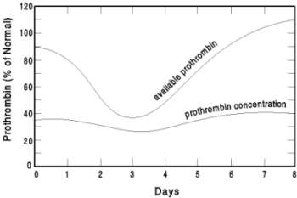

Slide 38
Dan 2:31 Thou, O king, sawest, and behold a great image. This image, which was mighty, and whose brightness was excellent, stood before thee; and the aspect thereof was terrible.
Dan 2:32 As for this image, his head was of fine gold, his breast and his arms of silver, his belly and his thighs of brass,
Dan 2:33 his legs of iron, his feet part of iron, and part of clay.
Dan 2:34 Thou sawest till that a stone was cut out without hands, which smote the image upon his feet that were of iron and clay, and brake them in pieces.
Dan 2:35 Then was the iron, the clay, the brass, the silver, and the gold, broken in pieces together, and became like the chaff of the summer threshing–floors; and the wind carried them away, that no place was found for them: and the stone that smote the image became a great mountain, and filled the whole earth.
Dan 2:36 This is the dream; and we will tell the interpretation thereof before the king.
Dan 2:37 Thou, O king, art king of kings, unto whom the God of heaven hath given the kingdom, the power, and the strength, and the glory;

Slide 39
Dan 2:38 and wheresoever the children of men dwell, the beasts of the field and the fowls of the heaven hath he given into thine hand, and hath made thee to rule over them all: thou art the head of gold.
Dan 2:39 And after thee shall arise another kingdom inferior to thee; and another third kingdom of brass, which shall bear rule over all the earth.
Dan 2:40 And the fourth kingdom shall be strong as iron: forasmuch as iron breaketh in pieces and subdueth all things: and as iron that crusheth all these, shall it break in pieces and crush.
Dan 2:41 And whereas thou sawest the feet and toes, part of potters’ clay, and part of iron, it shall be a divided kingdom; but there shall be in it of the strength of the iron, forasmuch as thou sawest the iron mixed with miry clay.

Slide 40
Dan 2:42 And as the toes of the feet were part of iron, and part of clay, so the kingdom shall be partly strong, and partly broken.
Dan 2:43 And whereas thou sawest the iron mixed with miry clay, they shall mingle themselves with the seed of men; but they shall not cleave one to another, even as iron doth not mingle with clay.
Dan 2:44 And in the days of those kings shall the God of heaven set up a kingdom, which shall never be destroyed, nor shall the sovereignty thereof be left to another people; but it shall break in pieces and consume all these kingdoms, and it shall stand for ever.
Dan 2:45 Forasmuch as thou sawest that a stone was cut out of the mountain without hands, and that it brake in pieces the iron, the brass, the clay, the silver, and the gold; the great God hath made known to the king what shall come to pass hereafter: and the dream is certain, and the interpretation thereof sure.

Slide 41
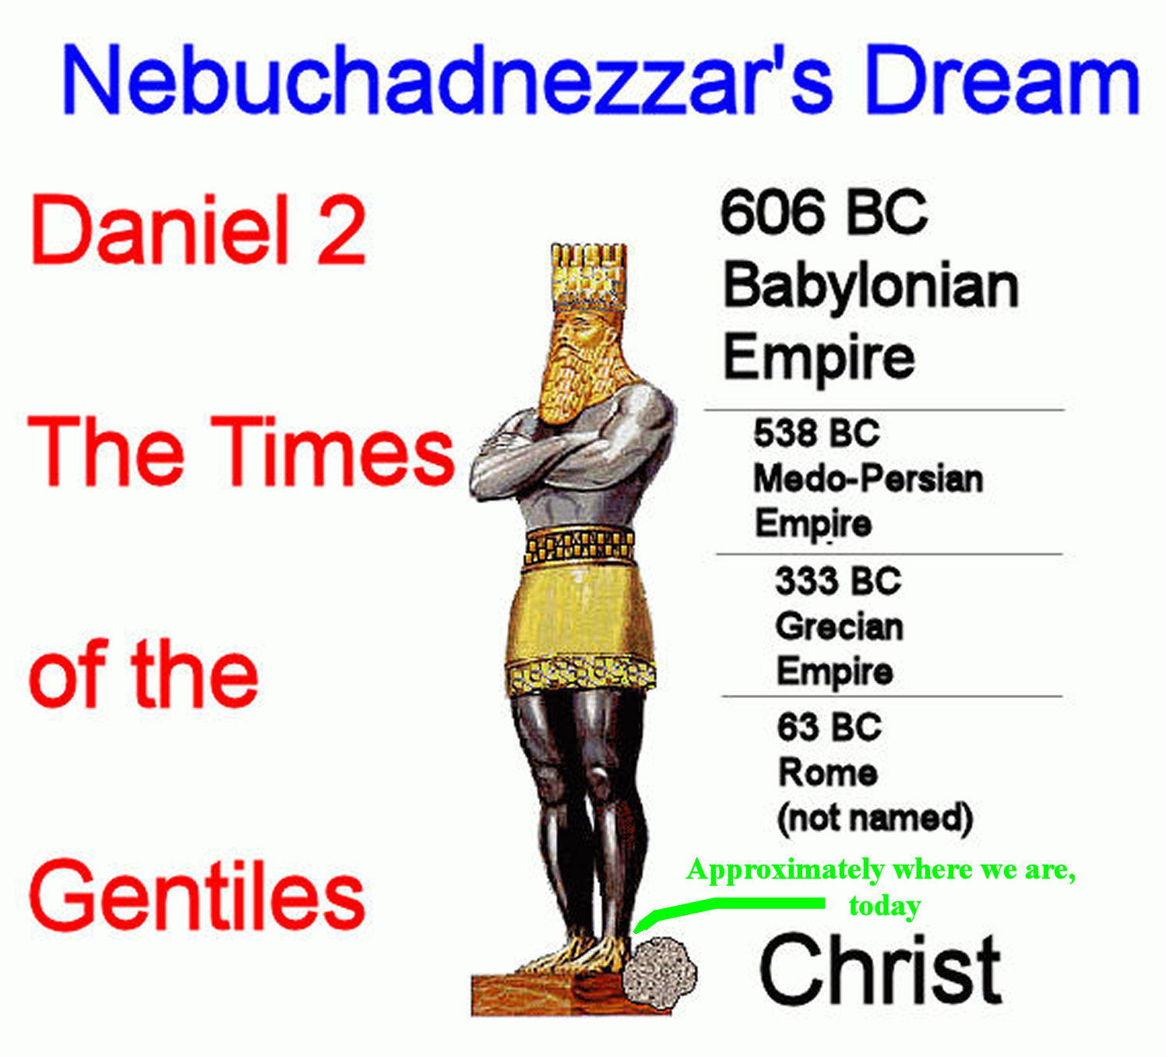

Slide 42
Gentile Kingdom Image
1Babylon
* Head of GOLD 625 B.C. TO 539 B.C.
2 Medo-Persia
* Chest and Arms of SILVER 539 B.C. TO 331 B.C.
3 Greece
* Waist and Thighs of
BRONZE 331 B.C. TO 164 B.C.
4Rome
* Legs of IRON164 B.C. - 70 A.D.

Slide 43
So accurate that skeptics say it must be written after the fulfilment.
However, the Septuagint was written 3rd century BC before Roman empire.
Also the presence of Aramaic language in the text proves its 500 BC period.

Slide 44
Dan 9:24 Seventy weeks are decreed upon thy people and upon thy holy city, to finish transgression, and to make an end of sins, and to make reconciliation for iniquity, and to bring in everlasting righteousness, and to seal up vision and prophecy, and to anoint the most holy.
Dan 9:25 Know therefore and discern, that from the going forth of the commandment to restore and to build Jerusalem unto the anointed one, the prince, shall be seven weeks: and threescore and two weeks, it shall be built again, with street and moat, even in troublous times.

Slide 45
Daniel's Visions, Accuracy of his Prophecies
HOW ACCURATE IS DANIEL
The accuracy of Daniel's prophecies is one of the reasons that so many skeptics advance the theory that the Book of Daniel was written around 162 BC by a Hellenist Jew named Judas Maccabaeus. The skeptic cannot reconcile Daniel's precision in any other way short of the obvious acceptance of God's inspiration, an apparently unacceptable choice. But the following aspect of the prophecy cannot be explained away by late dating.
Daniel's vision, in particular that part dealing with the first 69 weeks, intrigued Sir Robert Anderson, a retired Scotland Yard Inspector of the late 19th Century. Daniel 9 v.25 predicts: "Know and discern that from the issuing of a decree to restore and build Jerusalem until Messiah the Prince there will be seven weeks and sixty two weeks". Daniel's 70 Weeks

Slide 46
In other words, using the issuance of the only decree that authorized the rebuilding of both the city of Jerusalem and the Temple as a starting point (given by Artaxerxes Longimanus of Persia), 483 years later should bring us to the time of Jesus.
Sir Robert calculated these 7 weeks, plus 62 weeks or 483 years (69 x 7 = 483). Virtually every fair authority to examine them since has confirmed his calculations. Others, like Hoehner's Chronological Aspects of the Life of Christ, have carried Anderson's calculations even further.
Most agree that the only decree that fits the prophecy was the decree issued by King Artaxerxes (Nehemiah 2 v.1) or, the 20th year of his reign on the first day of the month of Nisan. The Greenwich Observatory confirmed the date as March 5, 444 BC. Anderson's calculations were among the first to recognize the Hebrew lunar calendar; it has a 360 day year, 12 months of 30 days each.
Anderson used a simple conversion process. The length of a year varied by calendar, but a day was still a day. By multiplying 483 years by 360 days we find the 69 weeks equal exactly 173,880 days.
From 444 BC to AD 33 is 477 years (according to our calendar) But AD 1 and 1 BC were the same year, so the actual length of time was 476 years. Multiplying 476 years by 365.242198179 (allowing for leap years, ect.) comes to 173,855 days, 6 hours, 52 minutes, 44 seconds.

Slide 47
Jesus fits the prophetic and Messianic mould

Slide 48
Edgar Edwinson
50 Owen St
Wanganui
New Zealand

Slide 49
A man
A descendant of Shem
A descendant of Abraham, Isaac and Jacob
A member of the nation of Israel
Belonging to the Tribe of Judah
Of the Family of David and Nathan
Conceived by the virgin Mary
JESUS

Slide 50
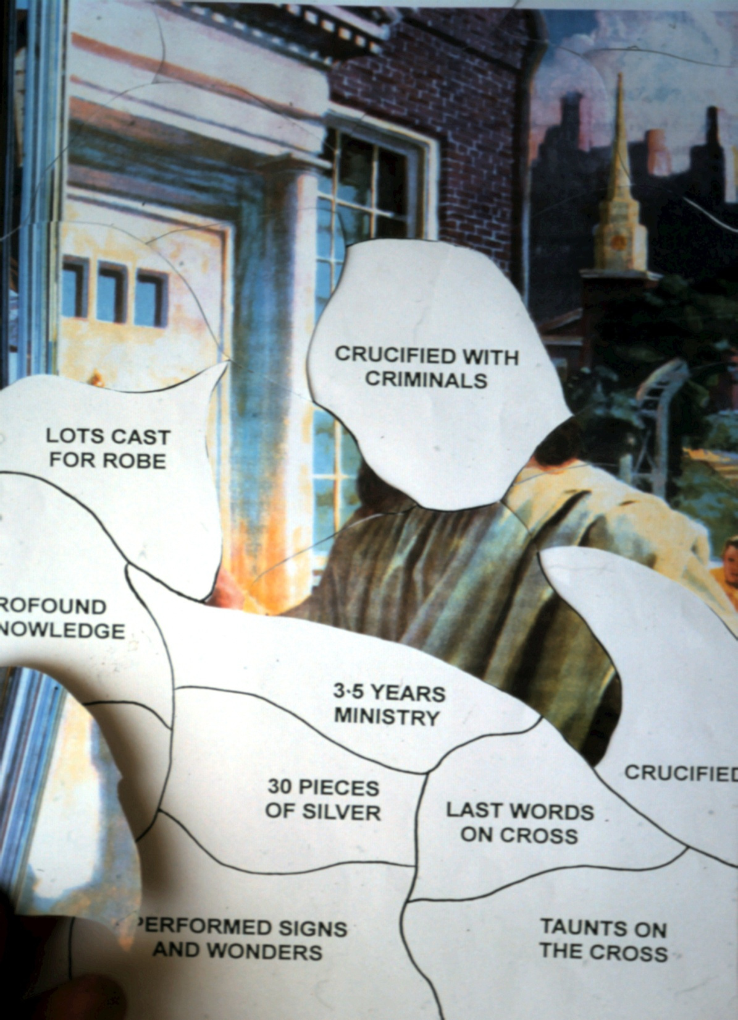

Slide 51
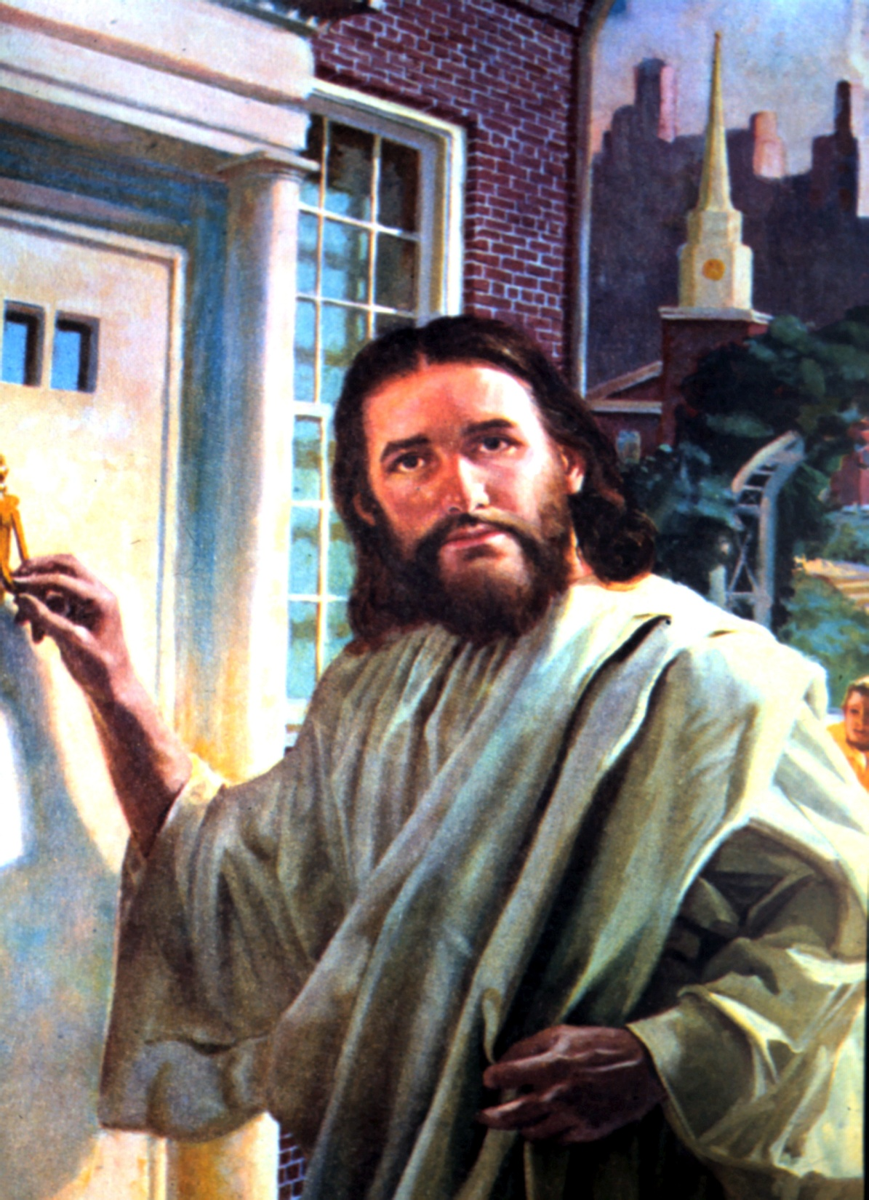

Slide 52
Num 24:17 I shall see him, but not now. I shall behold him, but not near. There shall come a Star out of Jacob, and a Scepter shall rise out of Israel, and shall strike the corners of Moab, and destroy all the sons of tumult.
Num 24:18 And Edom shall be a possession. Seir also shall be a possession for his enemies. And Israel shall do valiantly.
Num 24:19 Out of Jacob shall come He who shall have dominion and shall destroy him who remains of the city.
Mat 2:1 Now when Jesus was born in Bethlehem of Judea in the days of Herod the king, behold, wise men came from the east to Jerusalem,
Mat 2:2 saying, Where is He who is born king of the Jews? For we have seen His star in the east and have come to worship Him.

Slide 53
Mic 5:2 And you, Bethlehem Ephratah, you being least among the thousands of Judah, out of you He shall come forth to Me, to become Ruler in Israel, He whose goings forth have been from of old, from the days of eternity.

Slide 54
Zec 12:10 And I will pour on the house of David, and on the people of Jerusalem, the spirit of grace and of prayers. And they shall look on whom they have pierced, and they shall mourn for Him, as one mourns for his only son, and shall be bitter over Him, as the bitterness over the first-born.

Slide 55
Psa 89:27 I also will make him my firstborn, the highest of the kings of the earth.

Slide 56
Isa 53:9 And they made his grave with the wicked, and with the rich in his death; although he had done no violence, neither was any deceit in his month.
Isa 53:10 Yet it pleased the LORD to bruise him; he hath put him to grief: when thou shalt make his soul an offering for sin, he shall see his seed, he shall prolong his days, and the pleasure of the LORD shall prosper in his hand.
Isa 53:11 He shall see of the travail of his soul, and shall be satisfied: by his knowledge shall my righteous servant justify many: and he shall bear their iniquities.
Isa 53:12 Therefore will I divide him a portion with the great, and he shall divide the spoil with the strong; because he poured out his soul unto death, and was numbered with the transgressors: yet he bare the sin of many, and made intercession for the transgressors.

Slide 57
Mat 27:57 And when even was come, there came a rich man from Arimathaea, named Joseph, who also himself was Jesus’ disciple:
Mat 27:58 this man went to Pilate, and asked for the body of Jesus. Then Pilate commanded it to be given up.
Mat 27:59 And Joseph took the body, and wrapped it in a clean linen cloth,
Mat 27:60 and laid it in his own new tomb, which he had hewn out in the rock: and he rolled a great stone to the door of the tomb, and departed.

Slide 58
Psa 22:18 They part my garments among them, and upon my vesture do they cast lots.
Mat 27:35 And when they had crucified him, they parted his garments among them, casting lots:

Slide 59
Psa 22:1 <For the Chief Musician; set to Aijeleth hash–Shahar. A Psalm of David.> My God, my God, why hast thou forsaken me? why art thou so far from helping me, and from the words of my roaring?
Mat 27:46 And about the ninth hour Jesus cried with a loud voice, saying, Eli, Eli, lama sabachthani? that is, My God, my God, why hast thou forsaken me?

Slide 60
Archaeology

Slide 61
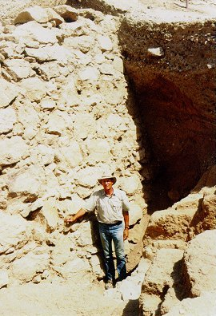

Slide 62
Three major expeditions to the site over the past 90 years uncovered abundant evidence to support the Biblical account," he said. As Wood went on to point out, John Garstang ( 1930-1936) and Kathleen Kenyon (1952-1958) both dug at Jericho for six seasons and a German excavation directed by Ernst Sellin and Carl Watzinger dug for three. All found abundant evidence of the city’s destruction by fire in a layer related to the Biblical date of 1400 BC.

Slide 63
THE "HOUSE OF DAVID": At Tel Dan in upper Galilee in Northern Israel a fragment of an inscription on basalt stone has been uncovered. It was part of the paving near the entrance of the outer gate of the ancient city of Dan. In 1992, in order to tidy up the site for presentation to visitors, a heap of debris was removed which dated from the time of the Assyrian destruction of the city by Tiglath-pileser lll - no doubt a legacy of his campaign against northern Israel. [2 Kings 15v29] Unexpectedly, a hitherto unknown gateway to the city was uncovered. The entrance led to a courtyard where stood a low stone platform large enough to take a throne. This possibly marked the place where the king would sit on ceremonial occasions. The Scriptures allude to such a custom when Ahab king of Israel and Jehoshaphat king of Judah sat in the gate of Samaria. [1 Kings 22v10] The inscription is a section of a victory stela (commemorative stone) about the conquests of one of the kings of Aram, recording the defeat of his foes, sometime in the 9th century BC. The inscription is written in Aramaic (a language closely related to early Hebrew) and is unique because it is the first reference found outside the Bible to 'The House of David.'

Slide 64
Josephus – Jewish historian mentions Jesus in his records as doing miracles.
He has been shown reliable in the Masada finds.

Slide 65
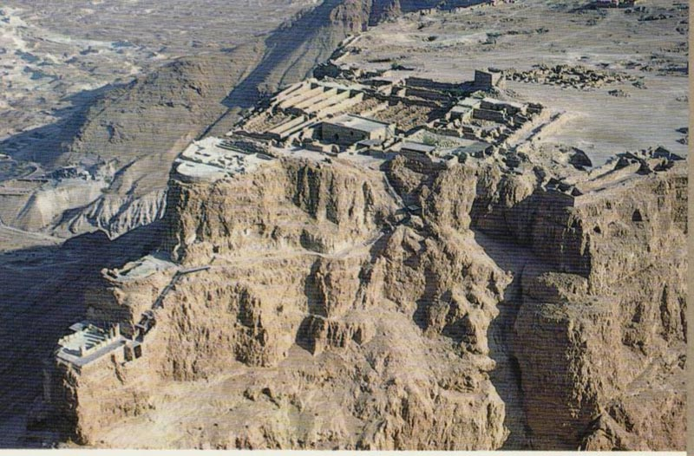

Slide 66
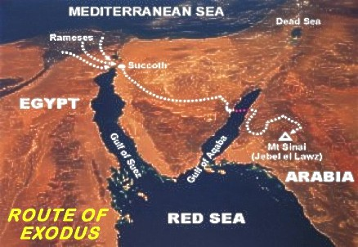

Slide 67
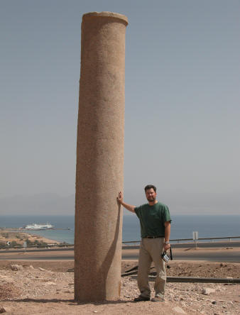
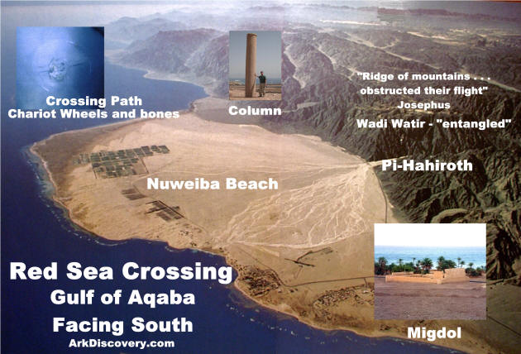

Slide 68
The names of Biblical places, kings, events have been confirmed by archaeology.

Slide 69
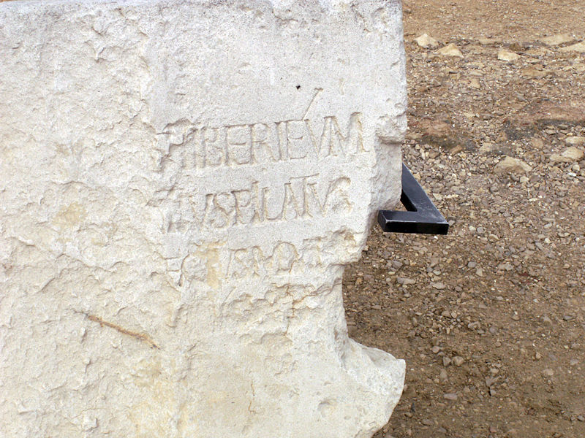
The first physical evidence relating to Pilate was discovered in 1961, when a block of limestone, the Pilate Stone, was found in the Roman theatre at Caesarea Maritima, the capital of the province of Judaea (Iudaea). Bearing a damaged dedication by Pilate of a Tiberieum, the dedication states that he was [...]ECTVS IUDA[...] (usually read as praefectus Iudaeae), that is, prefect of Judaea.

Slide 70
The first physical evidence relating to Pilate was discovered in 1961, when a block of limestone, the Pilate Stone, was found in the Roman theatre at Caesarea Maritima, the capital of the province of Judaea (Iudaea). Bearing a damaged dedication by Pilate of a Tiberieum, the dedication states that he was [...]ECTVS IUDA[...] (usually read as praefectus Iudaeae), that is, prefect of Judaea.

Slide 71
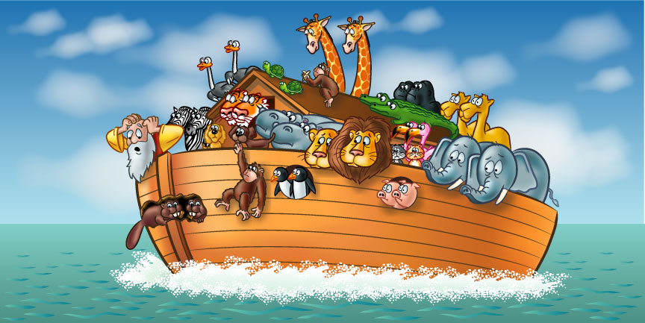
Noah and the flood was a children’s story.

Slide 72
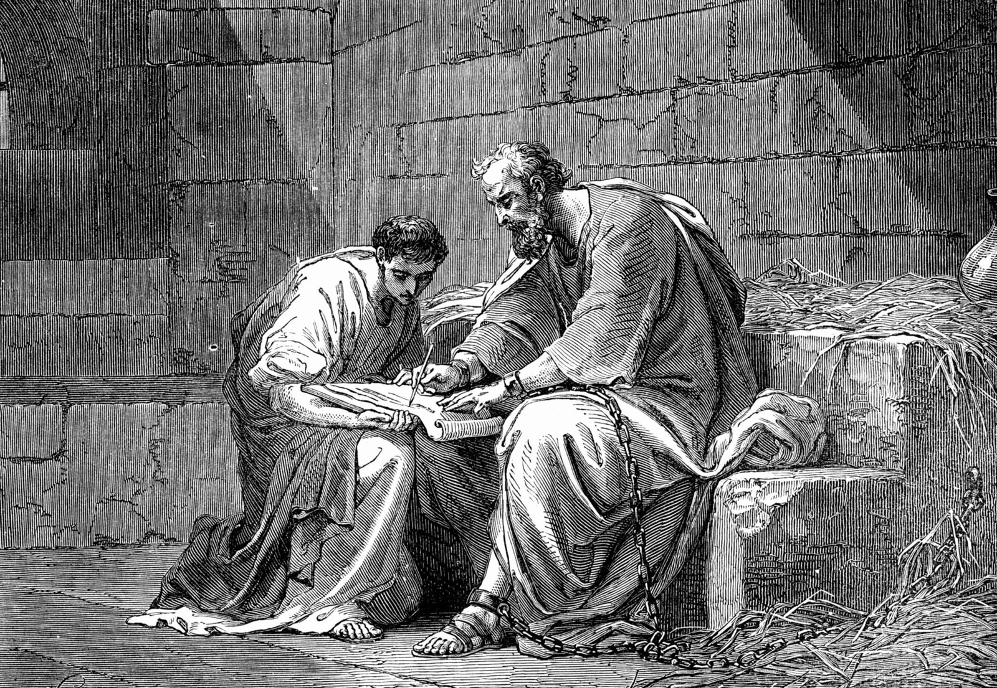

Slide 73
1Ti 2:12 But I permit not a woman to teach, nor to have dominion over a man, but to be in quietness.
1Ti 2:13 For Adam was first formed, then Eve;
1Ti 2:14 and Adam was not beguiled, but the woman being beguiled hath fallen into transgression:

Slide 74


Slide 75
Rom 3:3 For what if some were without faith? shall their want of faith make of none effect the faithfulness of God?
Rom 3:4 God forbid: yea, let God be found true, but every man a liar; as it is written, That thou mightest be justified in thy words, And mightest prevail when thou comest into judgment.

Slide 76
Psa 119:160 Your Word is true from the beginning; and every one of Your righteous judgments endures forever.

