Slide 1
How to study the Bible and share it with others

Slide 2
Product Knowledge:
No substitute for Bible reading

Slide 3
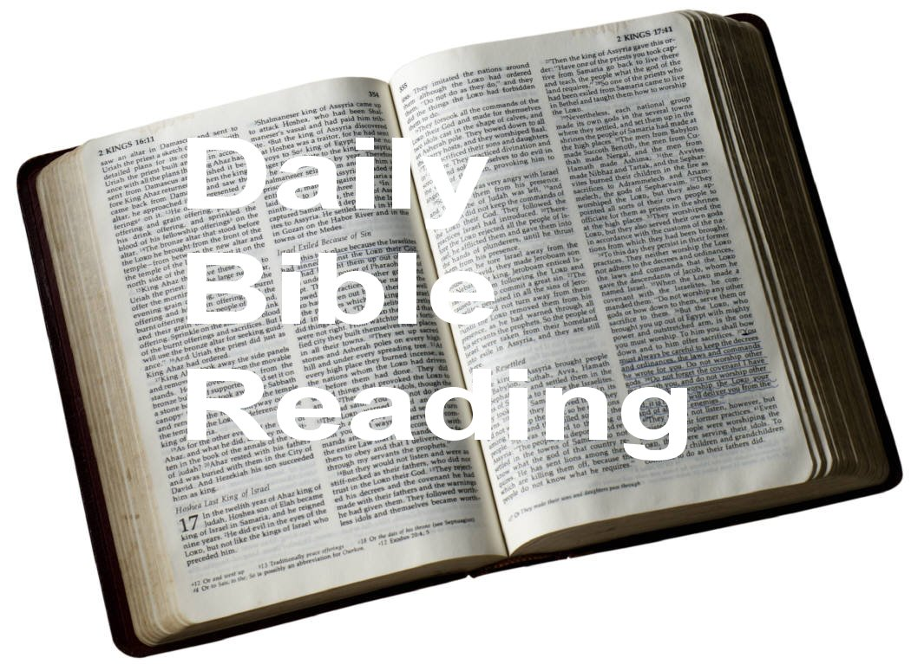

Slide 4


Slide 5


Slide 6
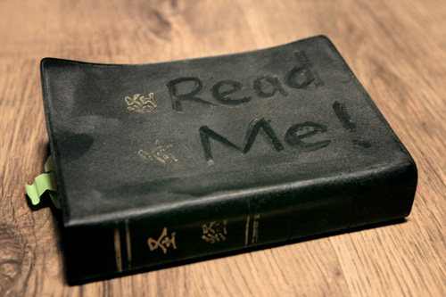

Slide 7
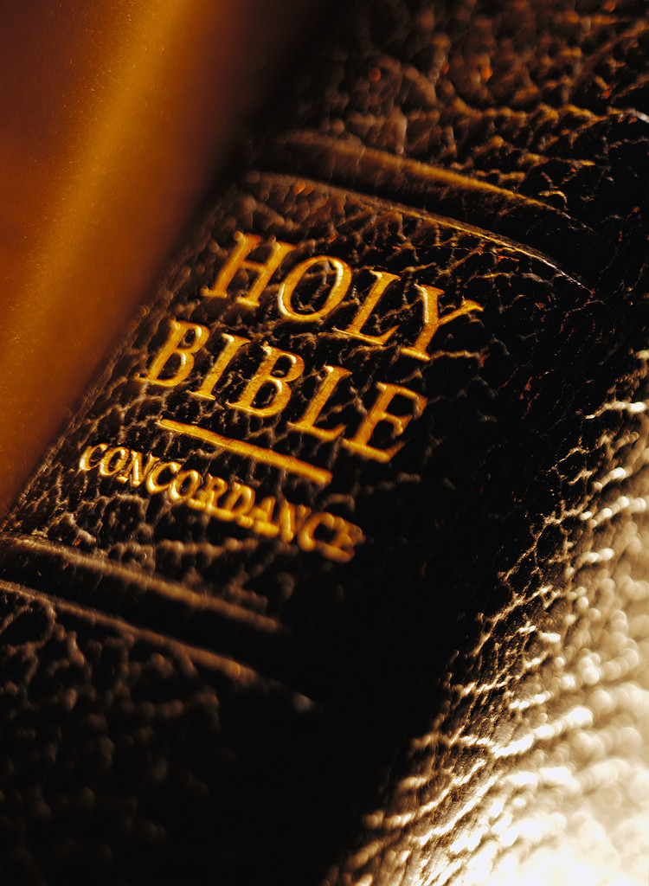
What does the Bible say?

Slide 8
Rev 22:19 and if any man shall take away from the words of the book of this prophecy, God shall take away his part from the tree of life, and out of the holy city, which are written in this book.

Slide 9
Pro 30:5 Every word of God is pure; He is a shield to those who put their trust in Him.
Pro 30:6 Do not add to His Words, lest He reprove you and you be found a liar.

Slide 10
Pro 25:2 It is the glory of God to conceal the word, and the glory of kings to search out the word.

Slide 11
1Co 2:13 Which things also we speak, not in words which man’s wisdom teacheth, but which the Spirit teacheth; comparing spiritual things with spiritual.
1Co 2:14 Now the natural man receiveth not the things of the Spirit of God: for they are foolishness unto him; and he cannot know them, because they are spiritually judged.
1Co 2:15 But he that is spiritual judgeth all things, and he himself is judged of no man.
1Co 2:16 For who hath known the mind of the Lord, that he should instruct him? But we have the mind of Christ.

Slide 12
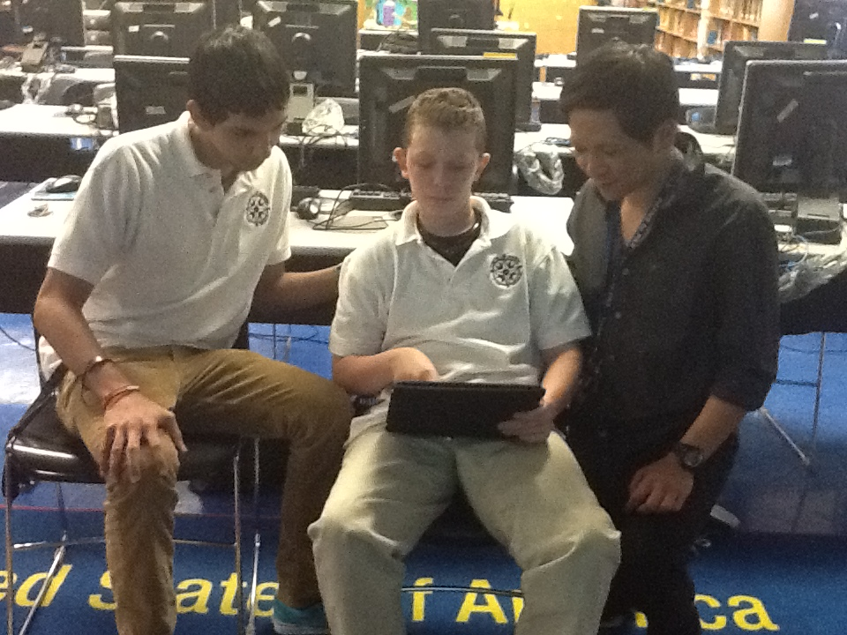

Slide 13
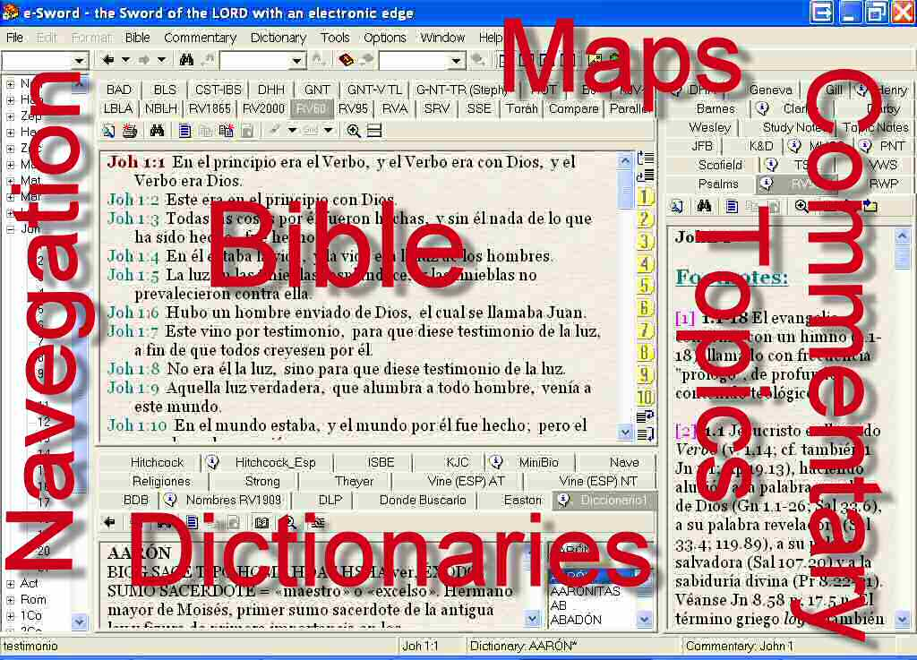

Slide 14
2Pe 3:15 And think of the long-suffering of our Lord as salvation (as our beloved brother Paul also has written to you according to the wisdom given to him
2Pe 3:16 as also in all his letters, speaking in them of these things; in which are some things hard to be understood, which the unlearned and unstable pervert, as also they do the rest of the Scriptures, to their own destruction).

Slide 15
Pro 11:14 Where no wise guidance is, the people falleth: but in the multitude of counsellors there is safety.

Slide 16
Jas 1:19 Therefore, my beloved brothers, let every man be swift to hear, slow to speak, slow to wrath.
Jas 1:20 For the wrath of man does not work out the righteousness of God.

Slide 17
It can be fun to speculate.
But speculation can lead us down dead end paths and into error.
It also detracts from the truth of God’s word revealed in his word.

Slide 18
Neh 8:6 and Ezra blessed the LORD, the great God. And all the people answered, Amen, Amen, with the lifting up of their hands: and they bowed their heads, and worshipped the LORD with their faces to the ground.
Neh 8:7 Also Jeshua, and Bani, and Sherebiah, Jamin, Akkub, Shabbethai, Hodiah, Maaseiah, Kelita, Azariah, Jozabad, Hanan, Pelaiah, and the Levites, caused the people to understand the law: and the people stood in their place.
Neh 8:8 And they read in the book, in the law of God, distinctly; and they gave the sense, so that they understood the reading.

Slide 19
Isa 28:9 Whom shall He teach knowledge? And whom shall He make to understand doctrine? Those weaned from the milk and drawn from the breasts.
Isa 28:10 For precept must be on precept, precept on precept; line on line, line on line; here a little, there a little;

Slide 20
2Ti 2:2 And the things which thou hast heard from me among many witnesses, the same commit thou to faithful men, who shall be able to teach others also.

Slide 21
What is wisdom?

Slide 22
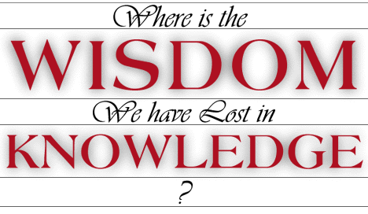
What is wisdom?

Slide 23
Pro 24:3 Through wisdom a house is built, and by understanding it is established;

Slide 24
Wisdom , knowledge, understanding.
Similar terms but with differences.

Slide 25
Pro 4:7 Wisdom is the main thing; get wisdom; and with all your getting get understanding.

Slide 26
* Knowledge – knowing facts or information
* Wisdom – skillful appreciation of the information
* Understanding – skillful use of that knowledge

Slide 27
How to share it with others

Slide 28
Mat 13:51 Jesus said to them, Have you understood all these things? They said to Him, Yes, Lord.
Mat 13:52 Then He said to them, Therefore every scribe who is instructed to the kingdom of Heaven is like a man who is a householder, who brings out things new and old out of his treasure.

Slide 29
Mal 3:16 Then they that feared the LORD spake one with another: and the LORD hearkened, and heard, and a book of remembrance was written before him, for them that feared the LORD, and that thought upon his name.

Slide 30
Mar 16:15 And he said unto them, Go ye into all the world, and preach the gospel to the whole creation.
Mar 16:16 He that believeth and is baptized shall be saved; but he that disbelieveth shall be condemned.

Slide 31
Mat 4:17 From that time Jesus began to preach and to say, Repent! For the kingdom of Heaven is at hand.
Mat 4:18 And walking by the Sea of Galilee, Jesus saw two brothers, Simon called Peter, and Andrew his brother, casting a net into the sea. For they were fishermen.
Mat 4:19 And He said to them, Follow Me, and I will make you fishers of men.

